Slide 1


How Many Polar Bears Can you Save with a Raspberry Pi?
Nefeli Zikou, Melina Zikou
4th High School of Alexandroupoli
nefeliz@live.com
24 November 2017

Slide 2
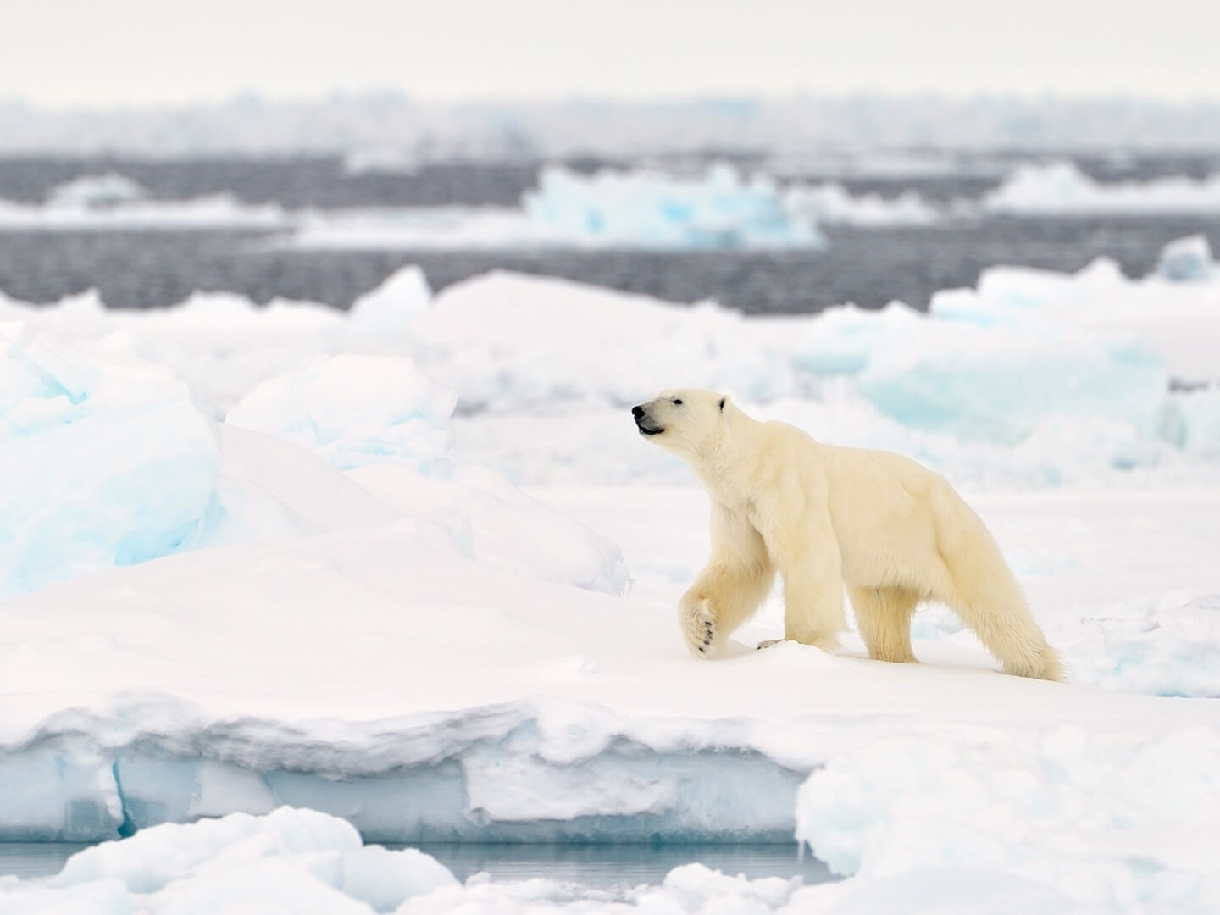
© Daniel J. Cox/NaturalExposures.com, http://polarbearsinternational.org/story/through-the-season/

Slide 3
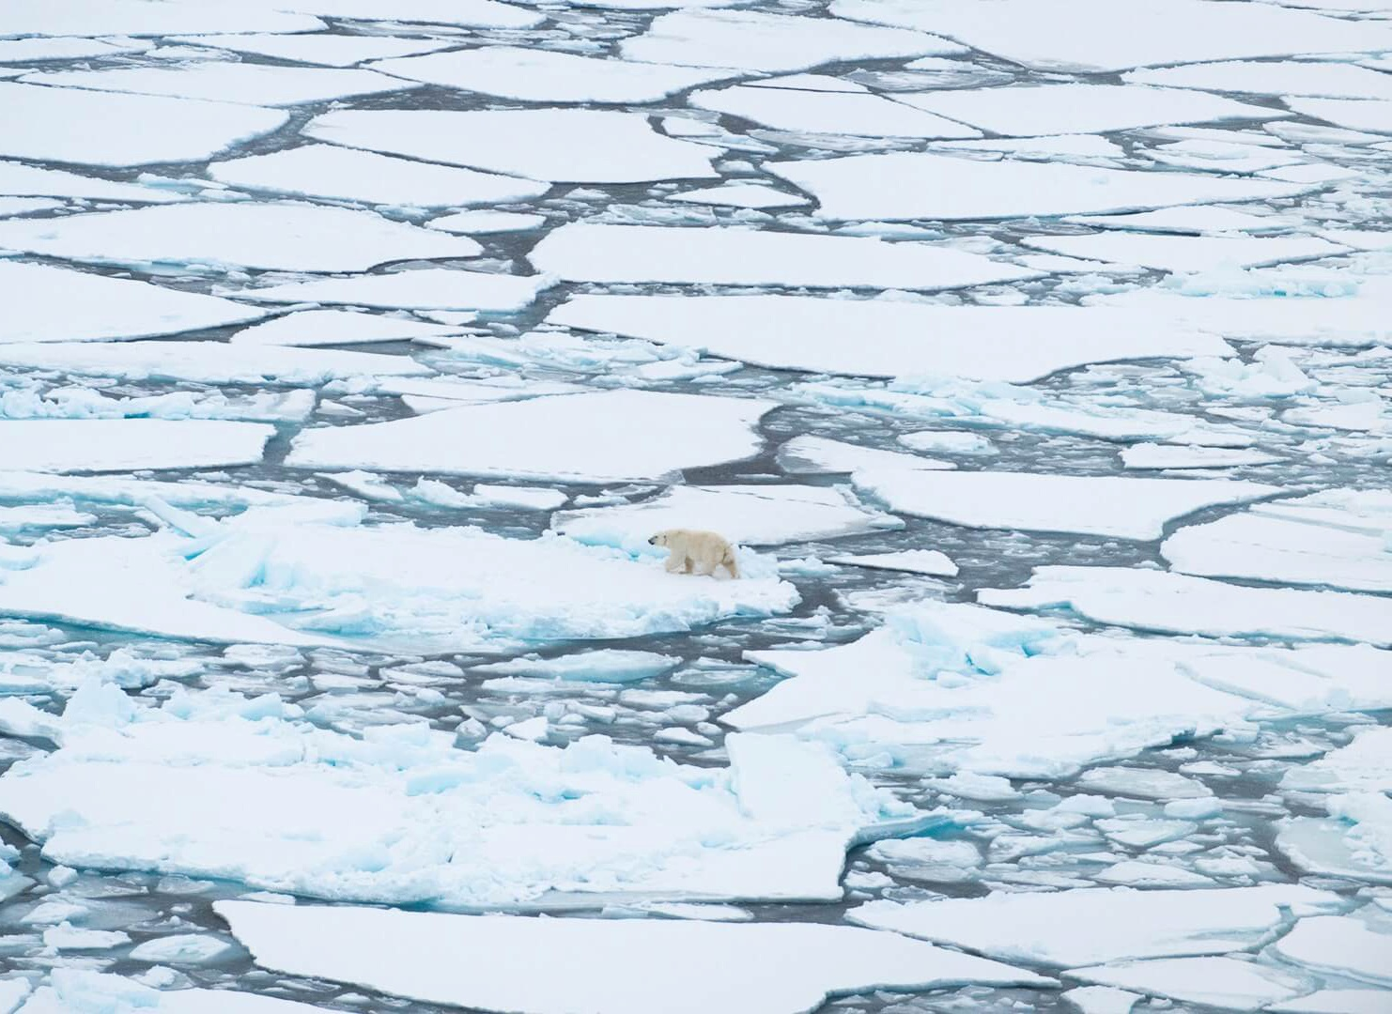
by 2100 all polar bears will be gone …
© Daniel J. Cox/NaturalExposures.com, http://polarbearsinternational.org/story/through-the-season/

Slide 4
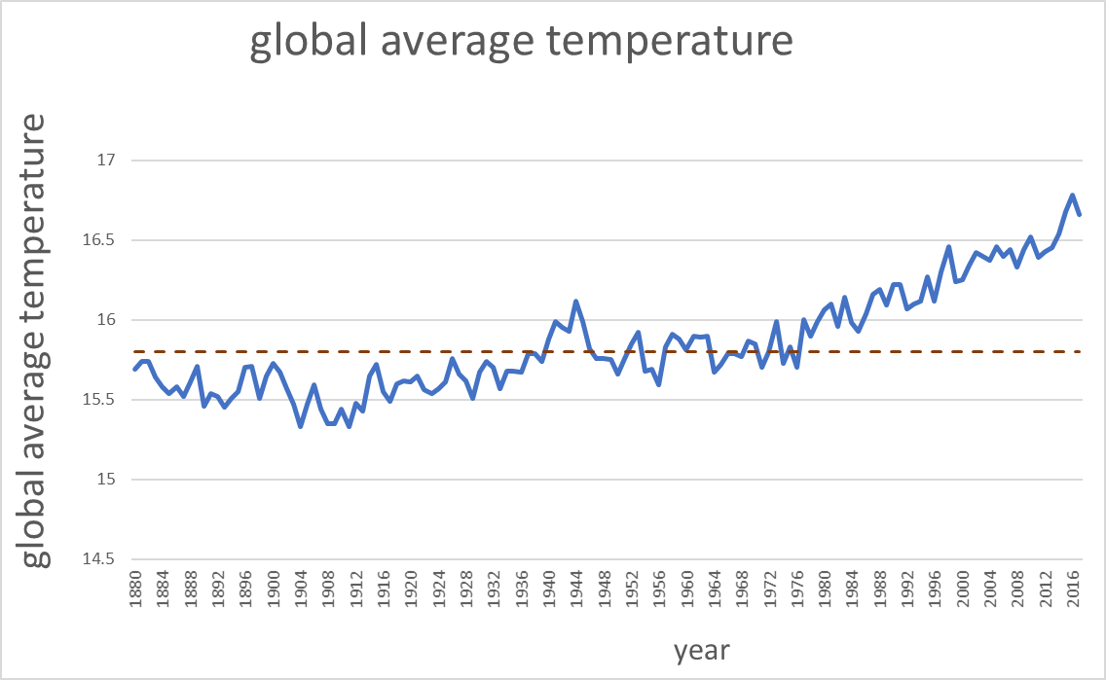
vital signs of the planet
Global Temperature
↑ 1ºC ^{since 1880}
Minimum Arctic Ice
↓ 13.8 % ^{per decade}
Land Ice
↓286 ^{GTons per year}
Sea Level
↑ 3.4 mm ^{per year}
CO₂
↑ 407.06 ^{parts per million}
15.8ºC: global temperature average for 20th century
Sources: Chart based on data reported by the National Centers for Environmental Information NOAA , USA https://www.ncdc.noaa.gov/sotc/global/201707
Vital signs of the planet by Global Climate Change, NASA, USA https://climate.nasa.gov/

Slide 5
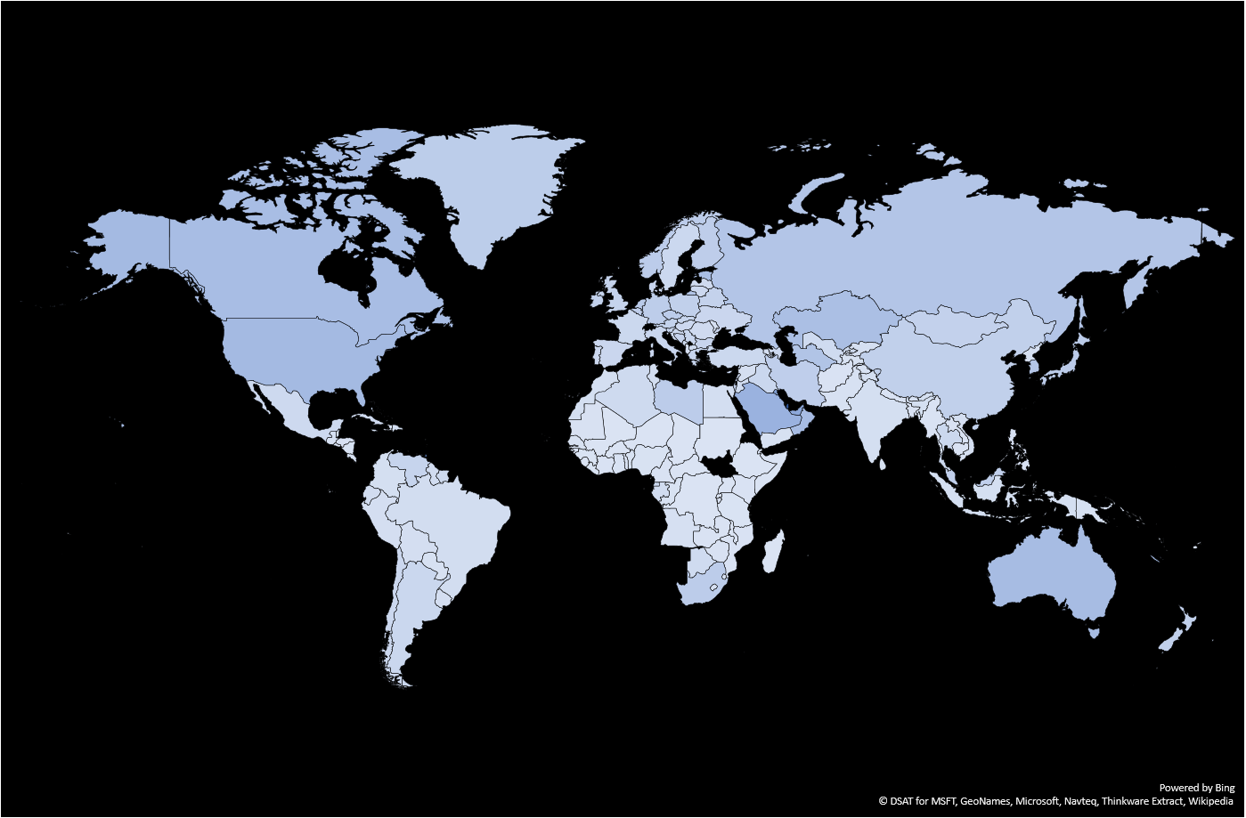
ice (m²) melted due to CO₂ emissions per country (2014)
Europe 19.5 m²
Greece 18.6 m²
Canada 45.33 m²
USA 49.5 m²
1 metric ton of CO₂ emissions results in
3m² of Arctic sea ice melt
India 5.2 m²
Brazil 7.8 m²
Australia 46.2 m²
Notz & Stroeve, Science 354(6313):747, 2016
Data from WorldBank: http://data.worldbank.org
Map created using Excel MapPoint

Slide 6
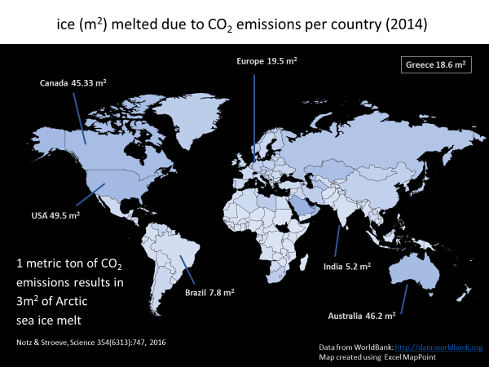
Just stop heating up the planet!!!!
Easiest way to do that:
Reduce the amount of electricity you consume
The absolutely super and most easy way to do that:
Switch off the lights, when you don’t need them!

Slide 7



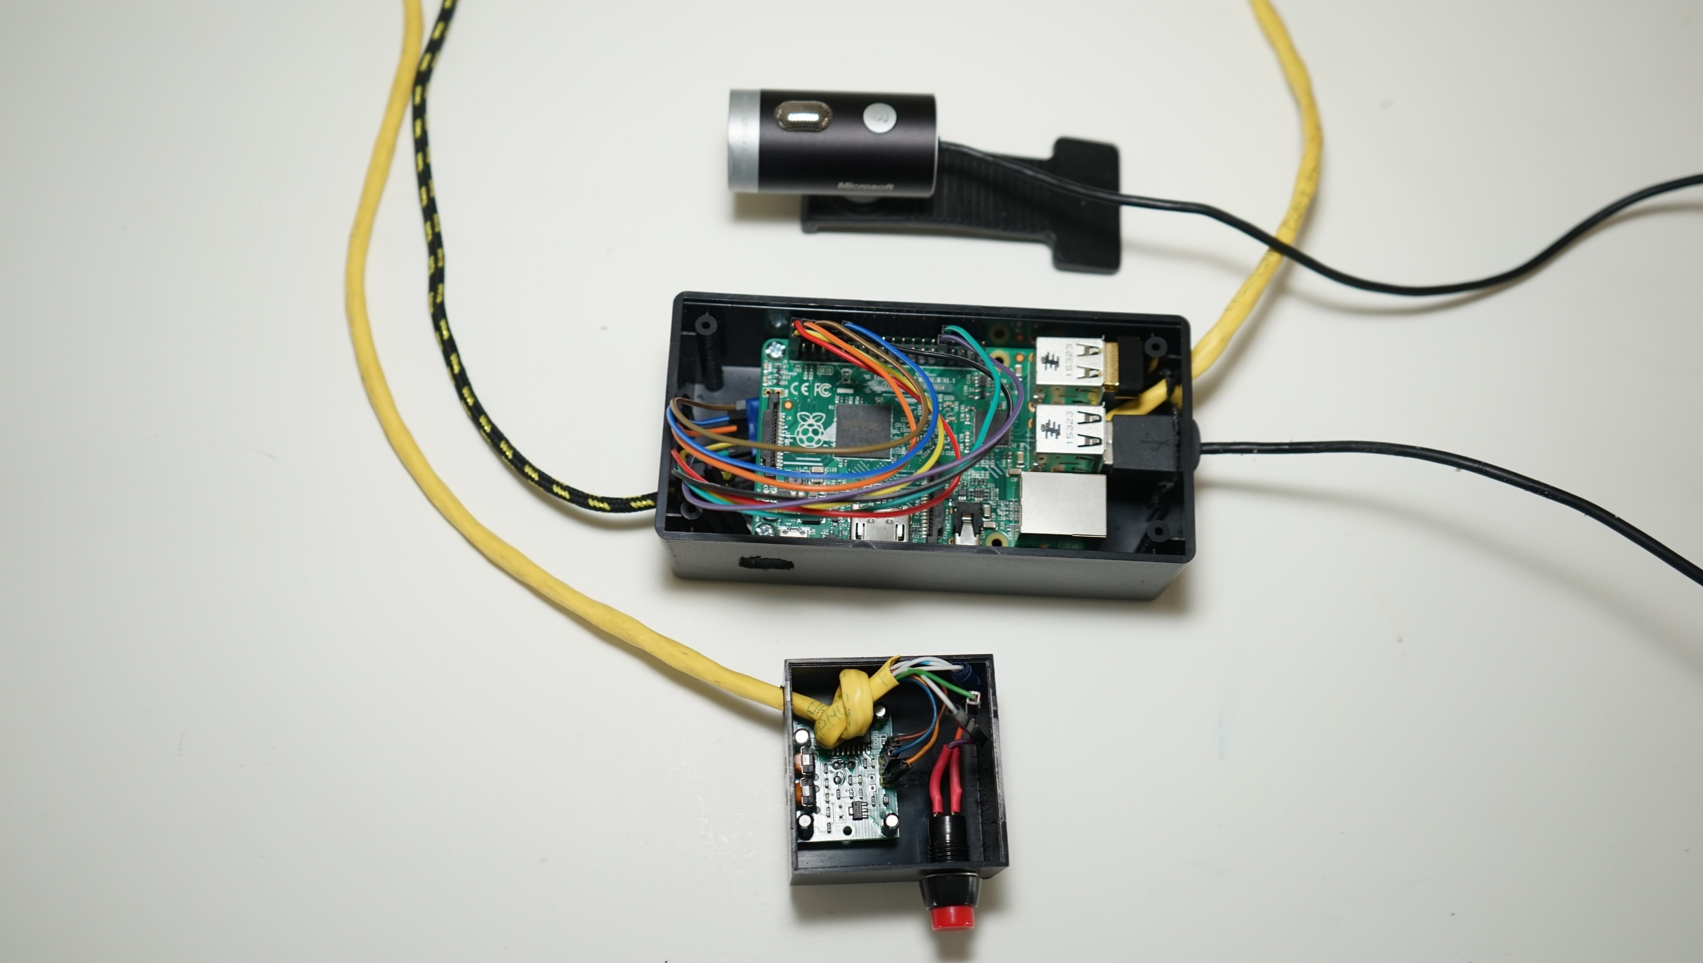
Plan A
Plan B
Plan C
electRuBus
electRuBus

Slide 8
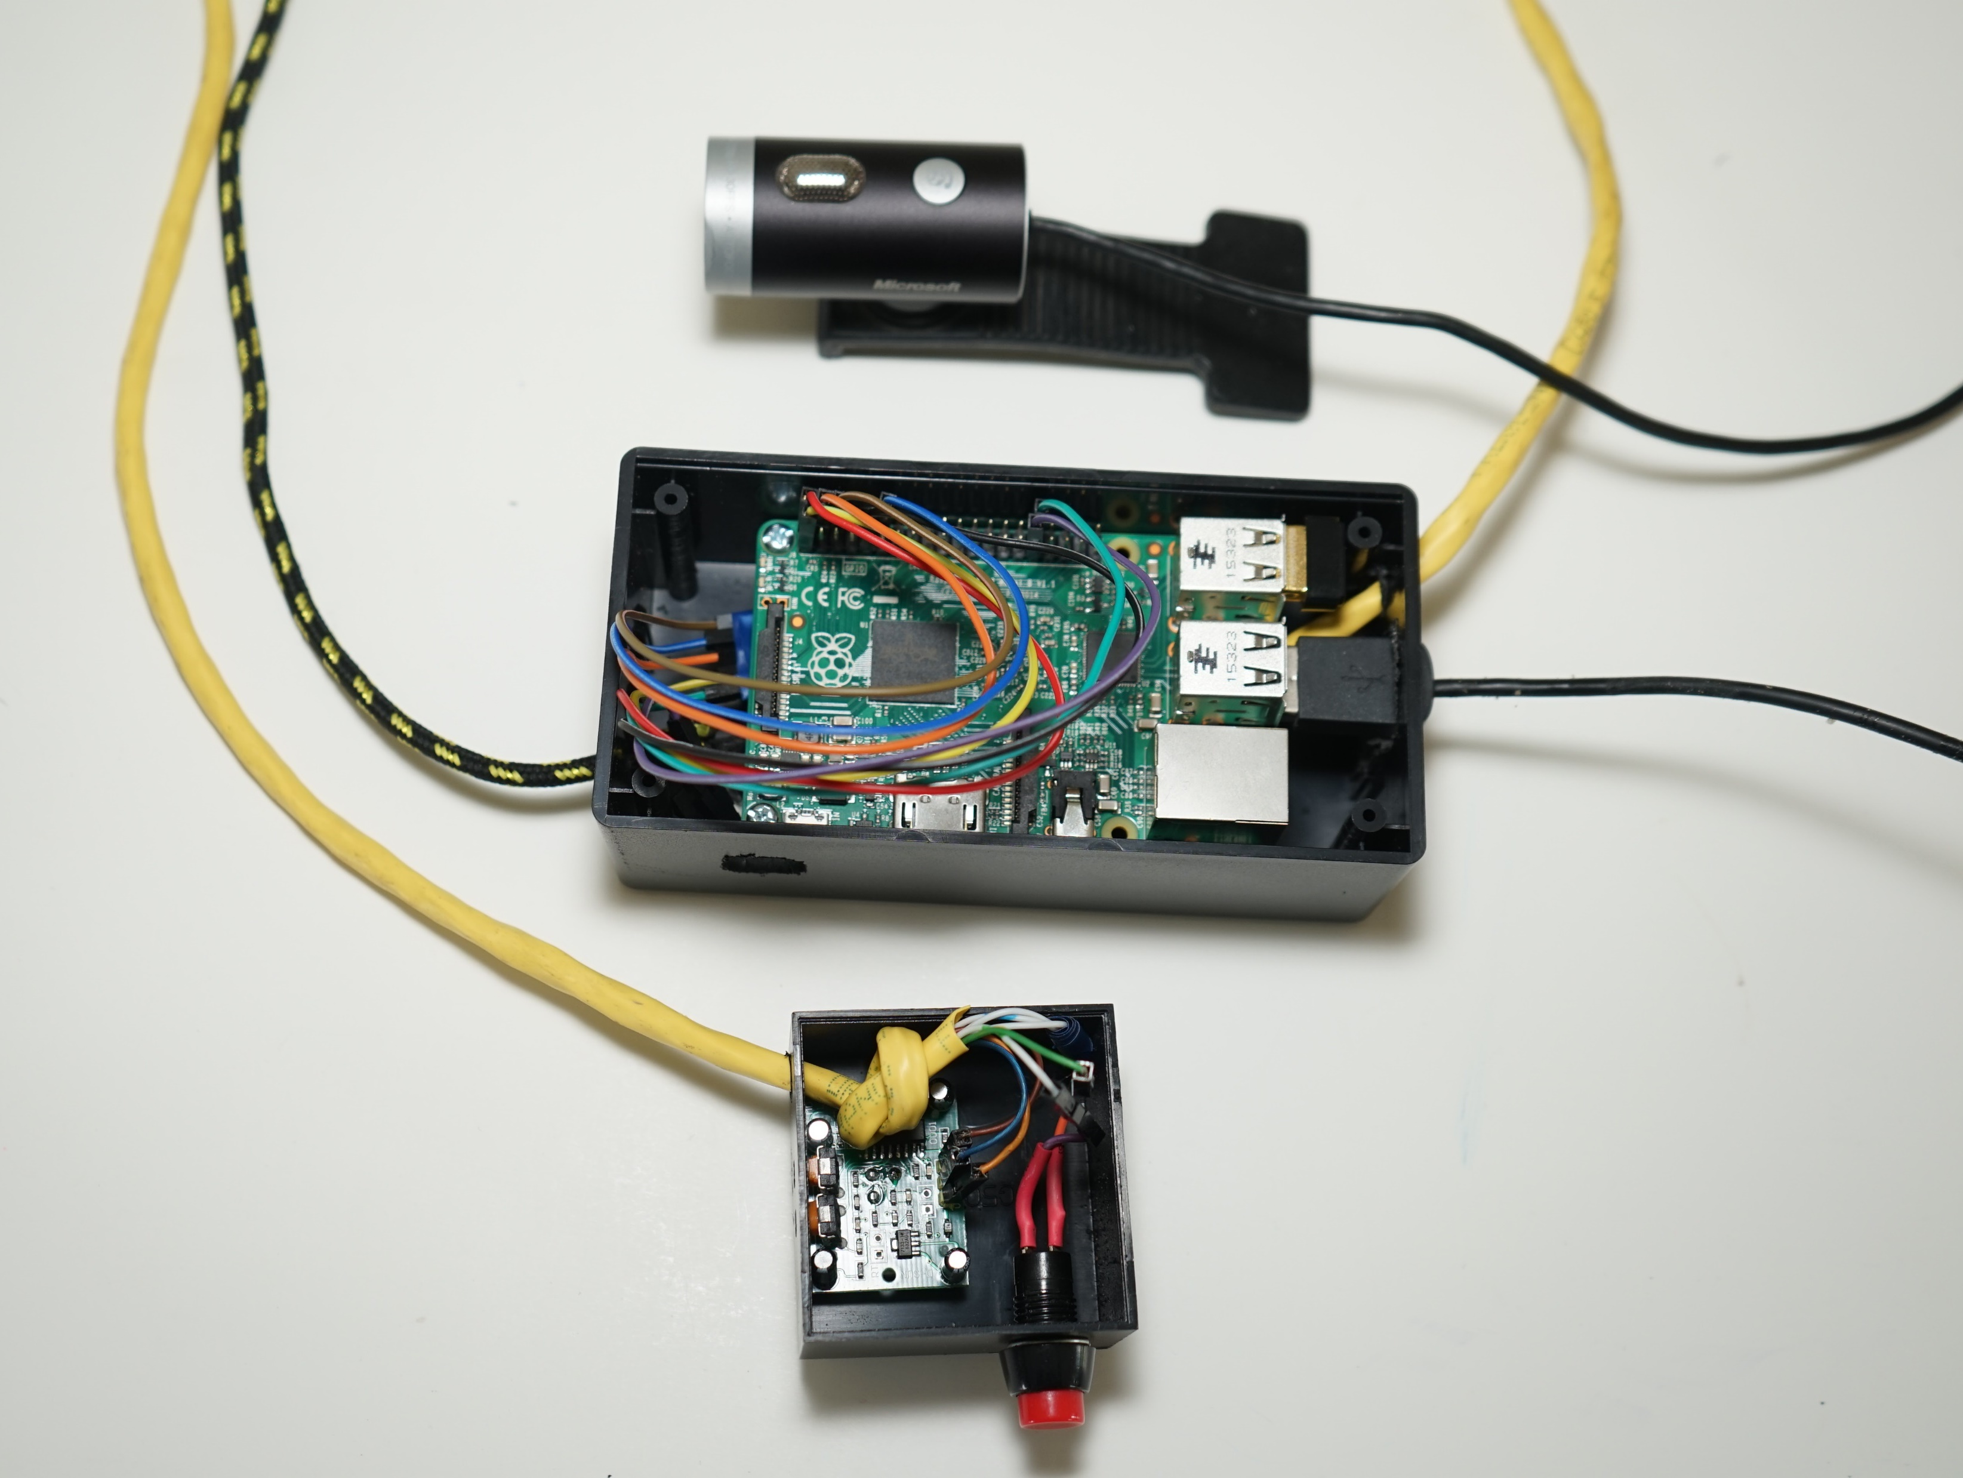
electRuBus
an inhouse smart plug and much more…
photo © Melina Zikou

Slide 9

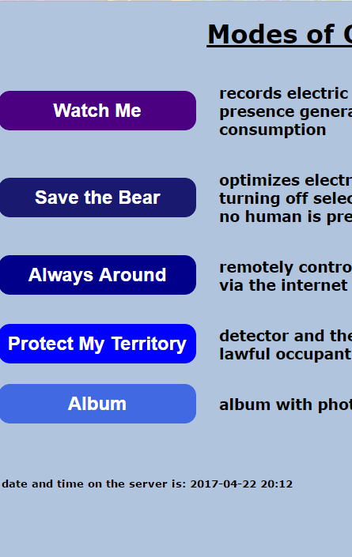










electRubus mobile app
electRubus IoT device
MODES
motion detector
camera
motion detection
Internet
camera control
micro-computer
electric devices to be monitored & controlled
electric outlet monitoring & control
electric outlet

Slide 10
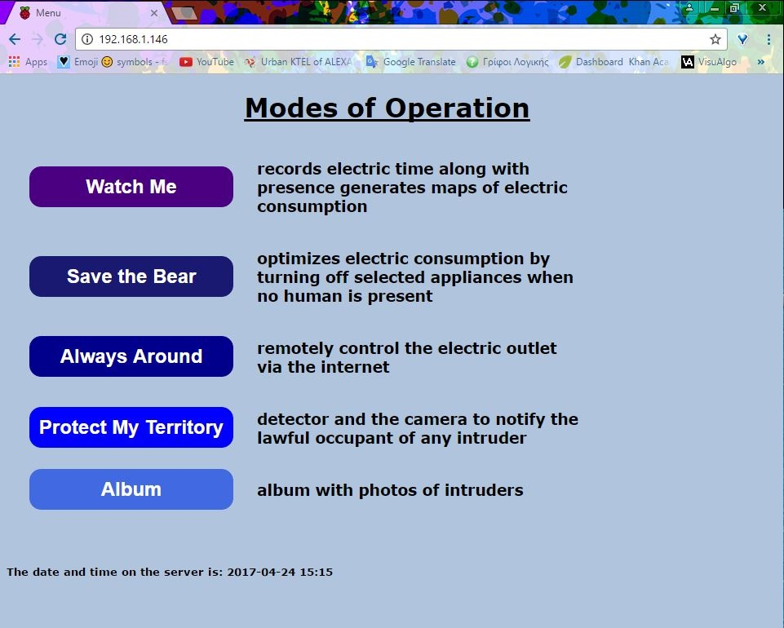
Records the time the outlet is on and off.
The total cost can be calculated.
Light is opened when movement is detected and switched off with absence of human.
Allows the user to turn on and off the light remotely and manually.
When movement is detected, a photo is taken for security purposes.
The photos are displayed here.
electRubus web application

Slide 11
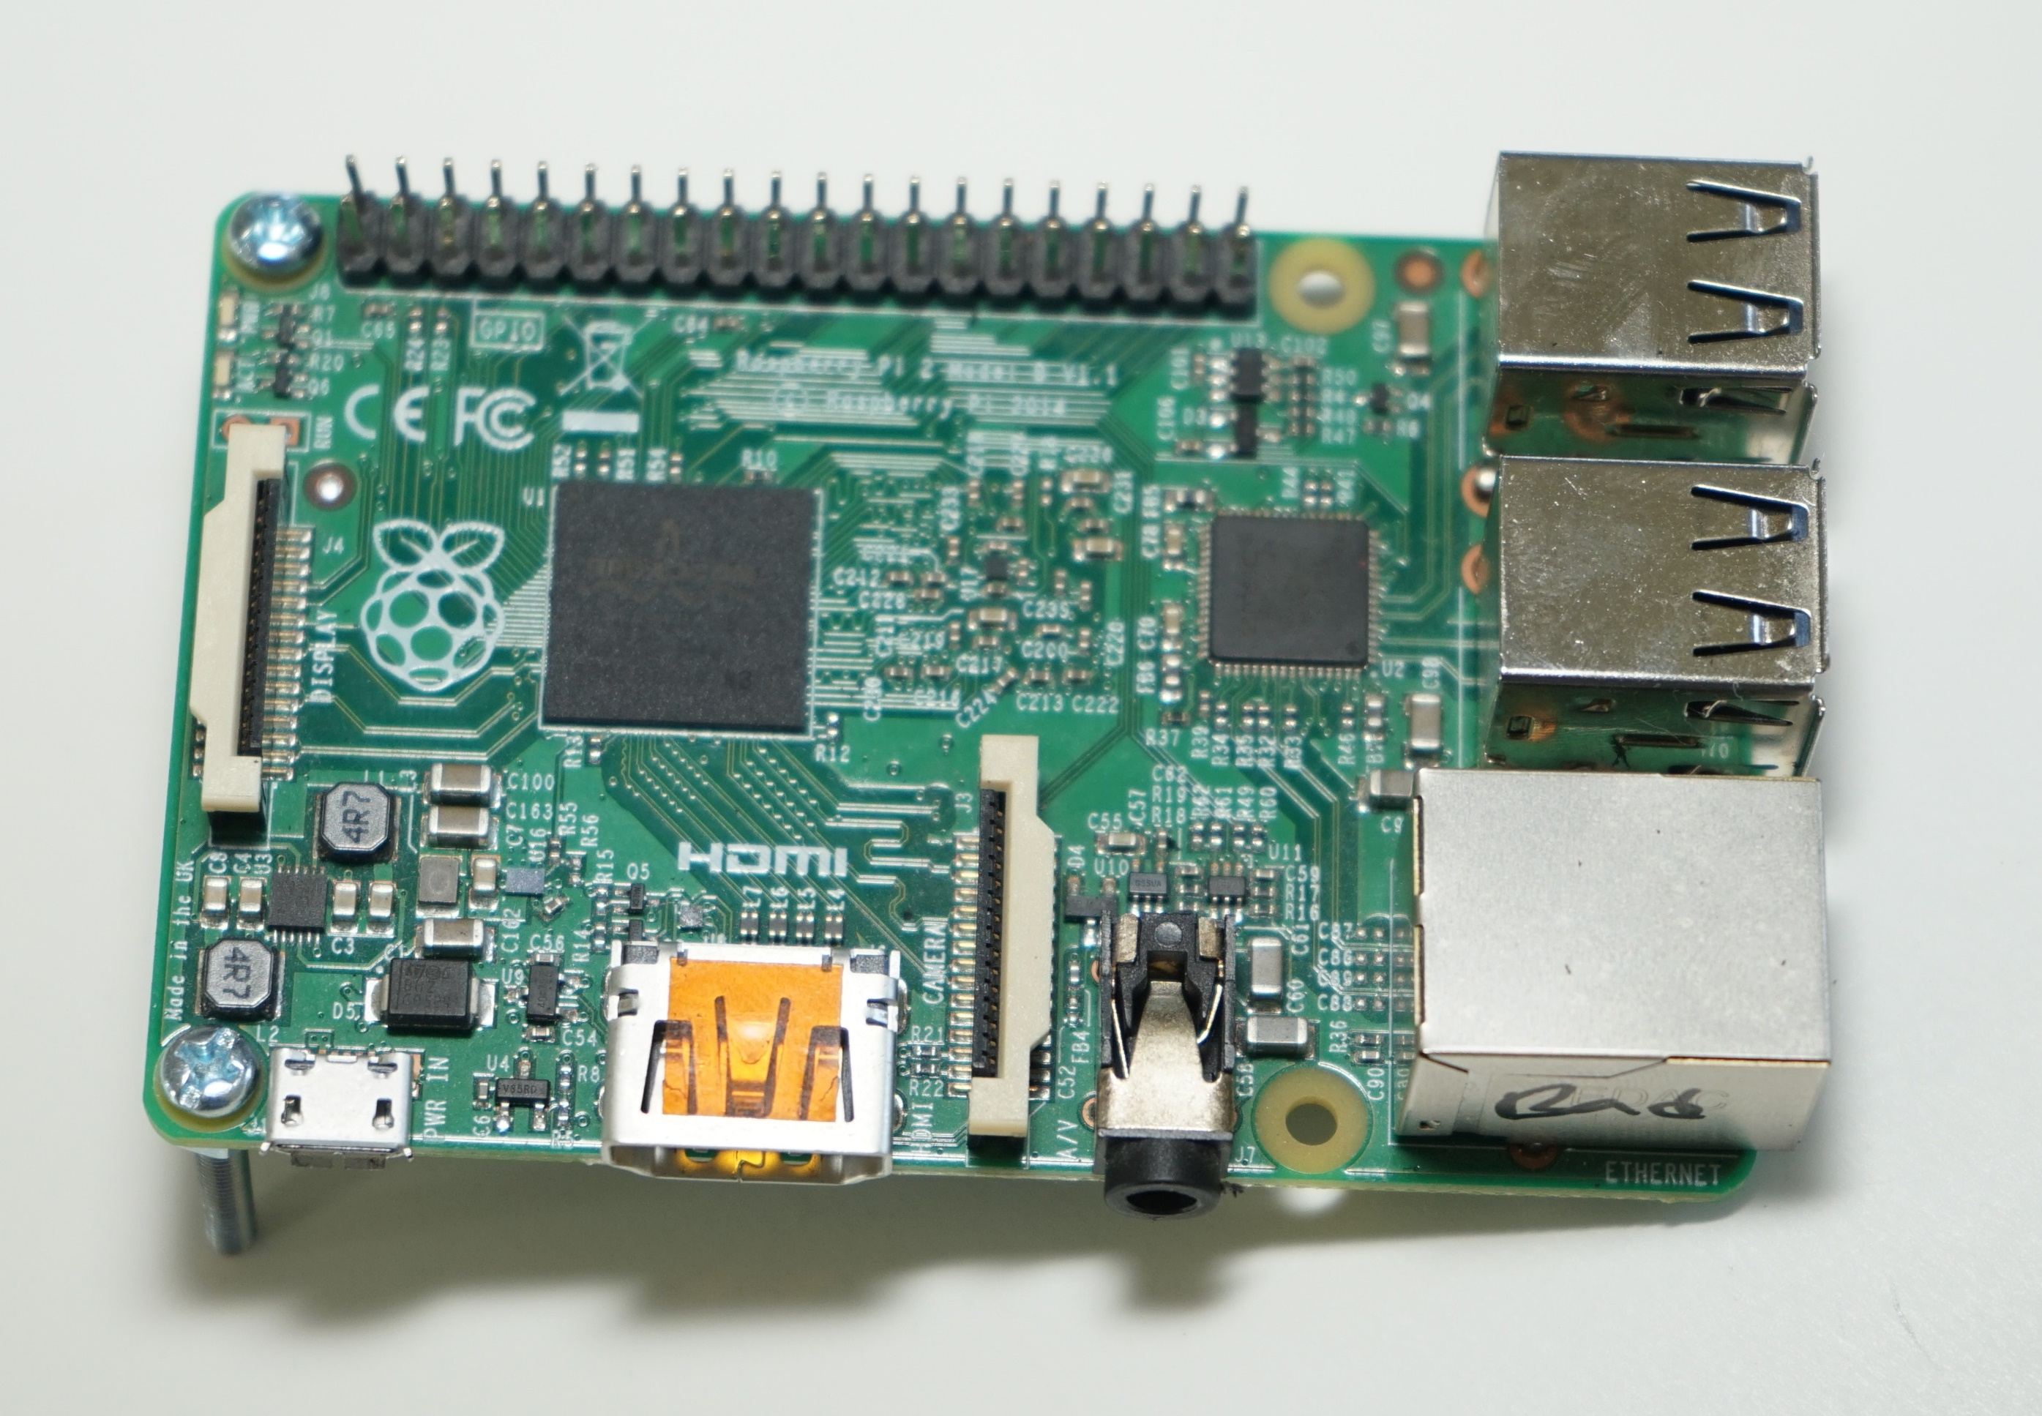

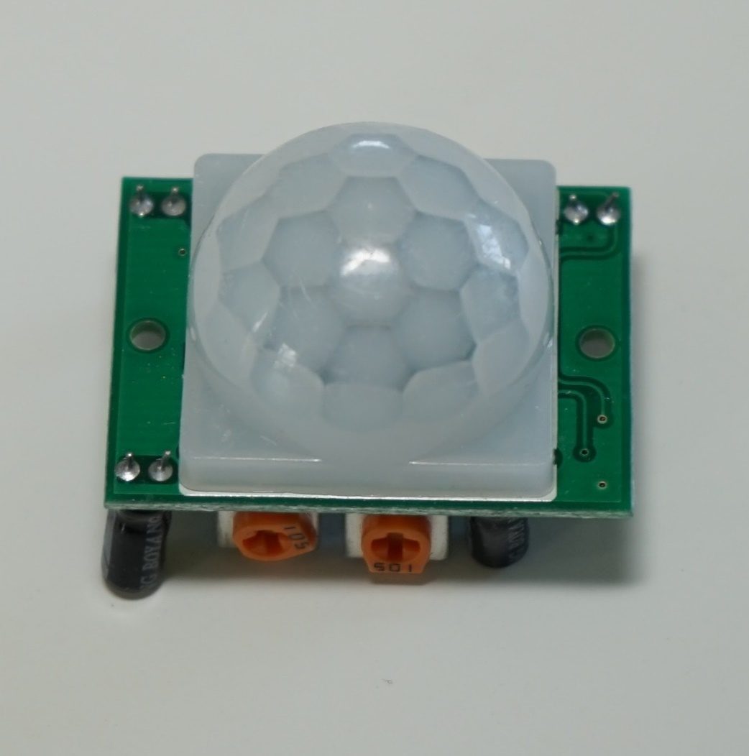
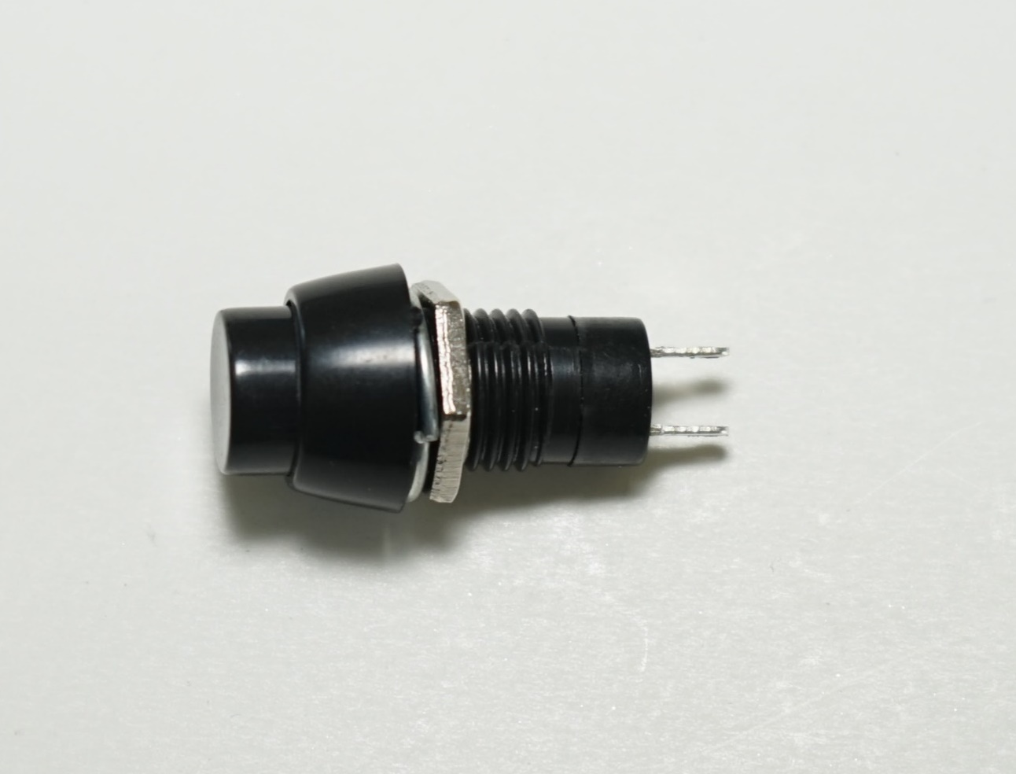
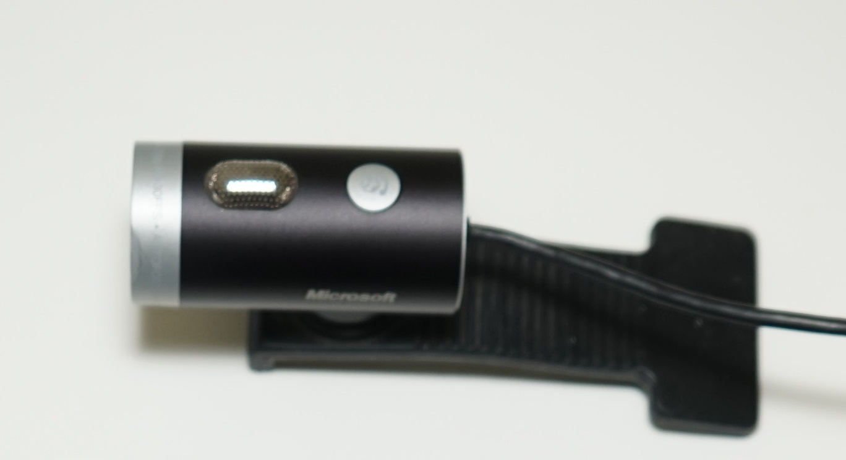
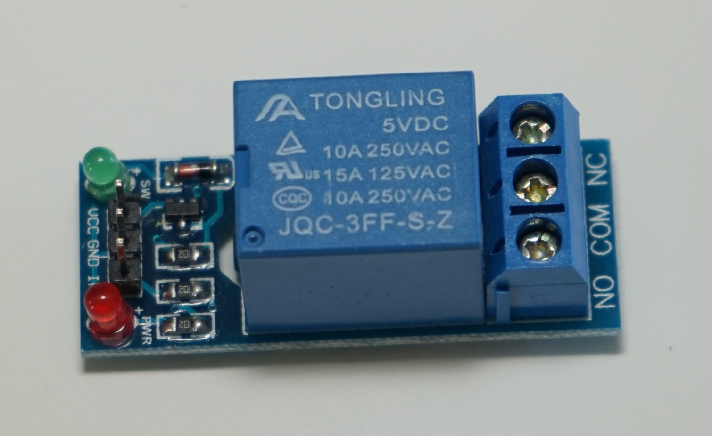
Raspberry Pi
– core of electRuBus
genus of plants like raspberry
+
electricity
=
Set of pins - General Purpose Input Output
electRubus
Infrared Sensor
Button
USB web camera
Relay

Slide 12
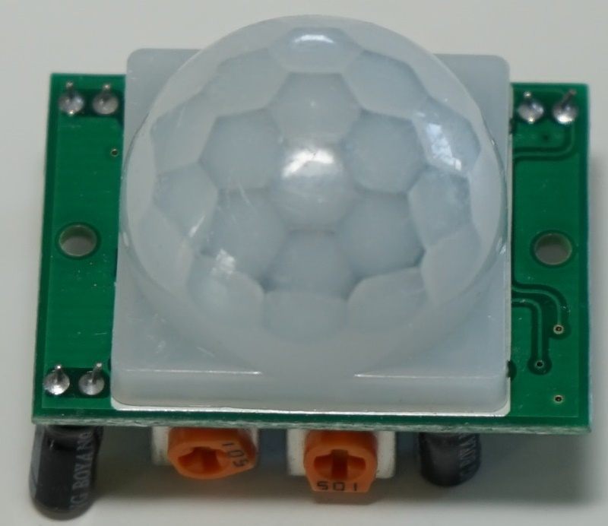
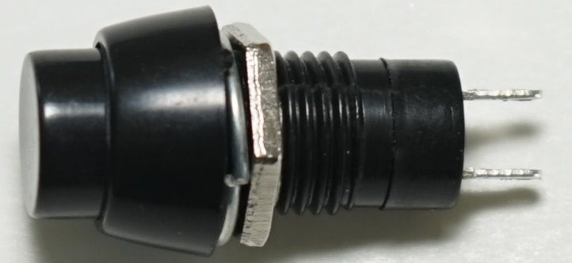

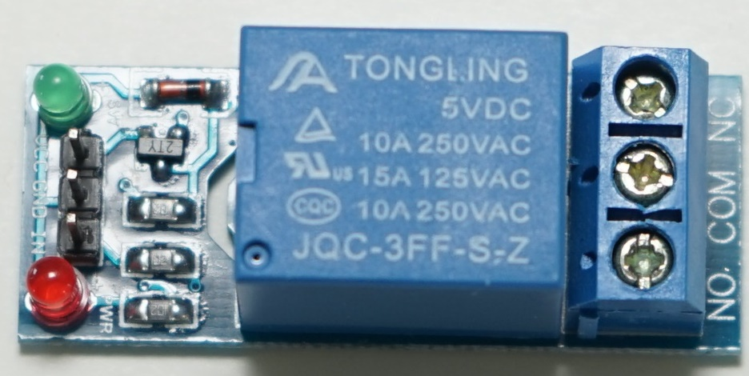



electRubus
connectivity schematic
infrared sensor
button
Raspberry PI GPIO
+5V
IN
GND
device
relay
USB web camera

Slide 13
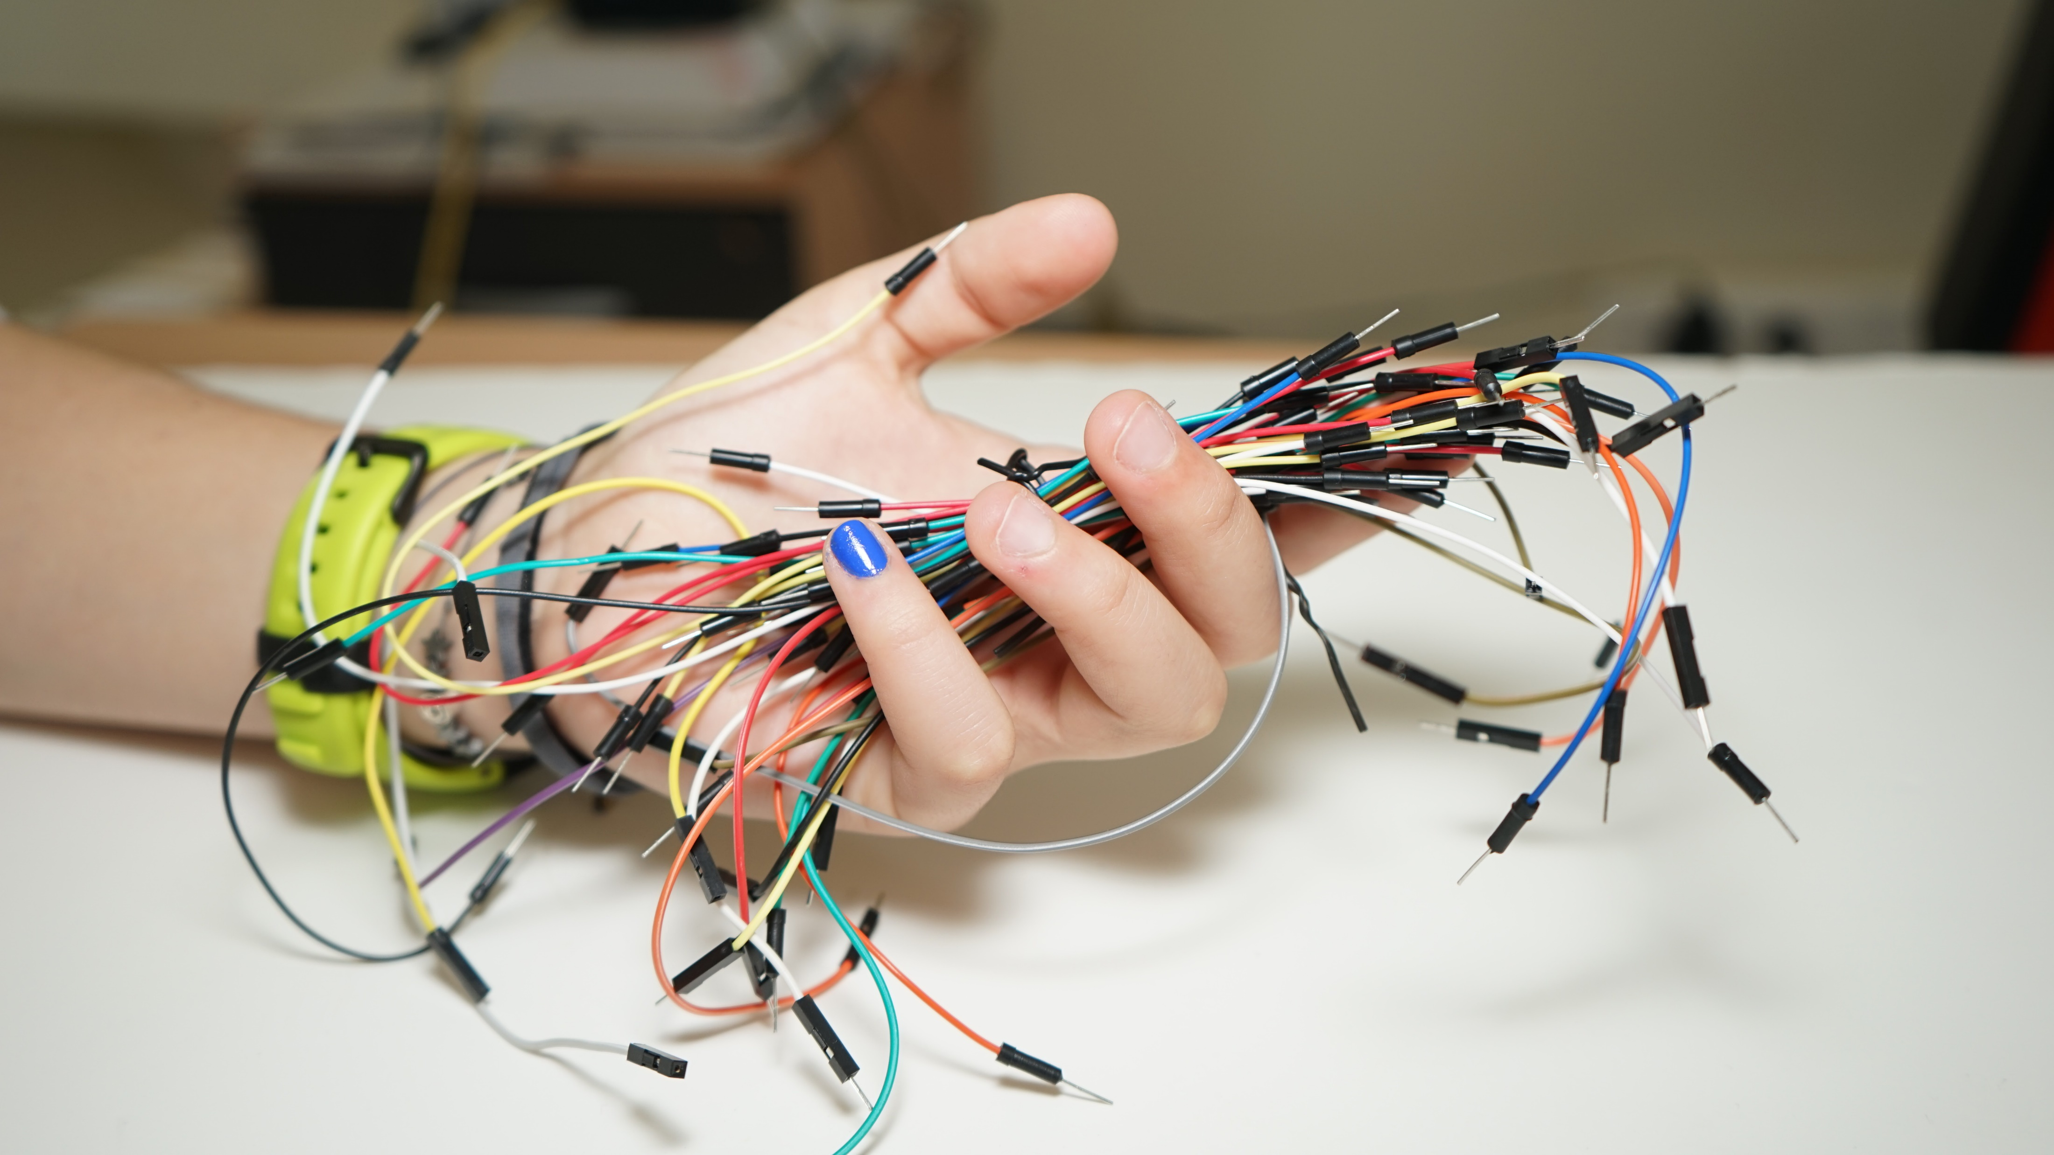
photo © Melina Zikou

Slide 14
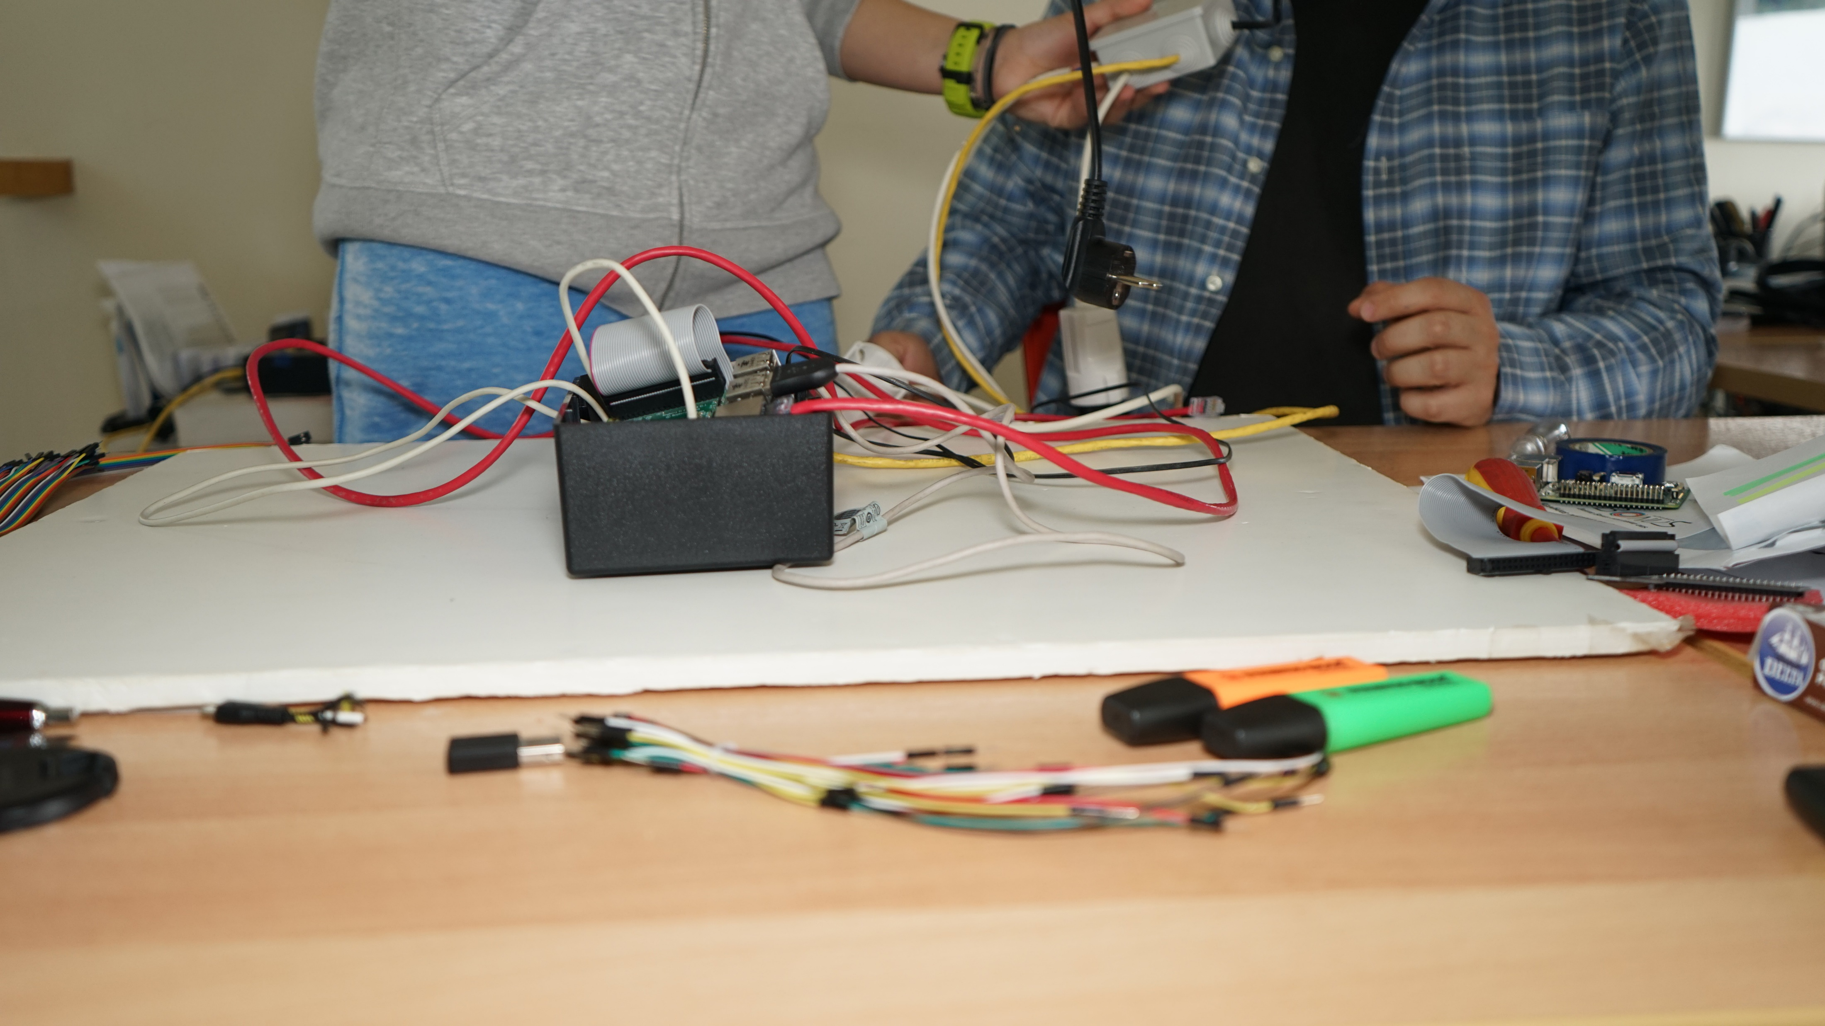
photo © Melina Zikou

Slide 15
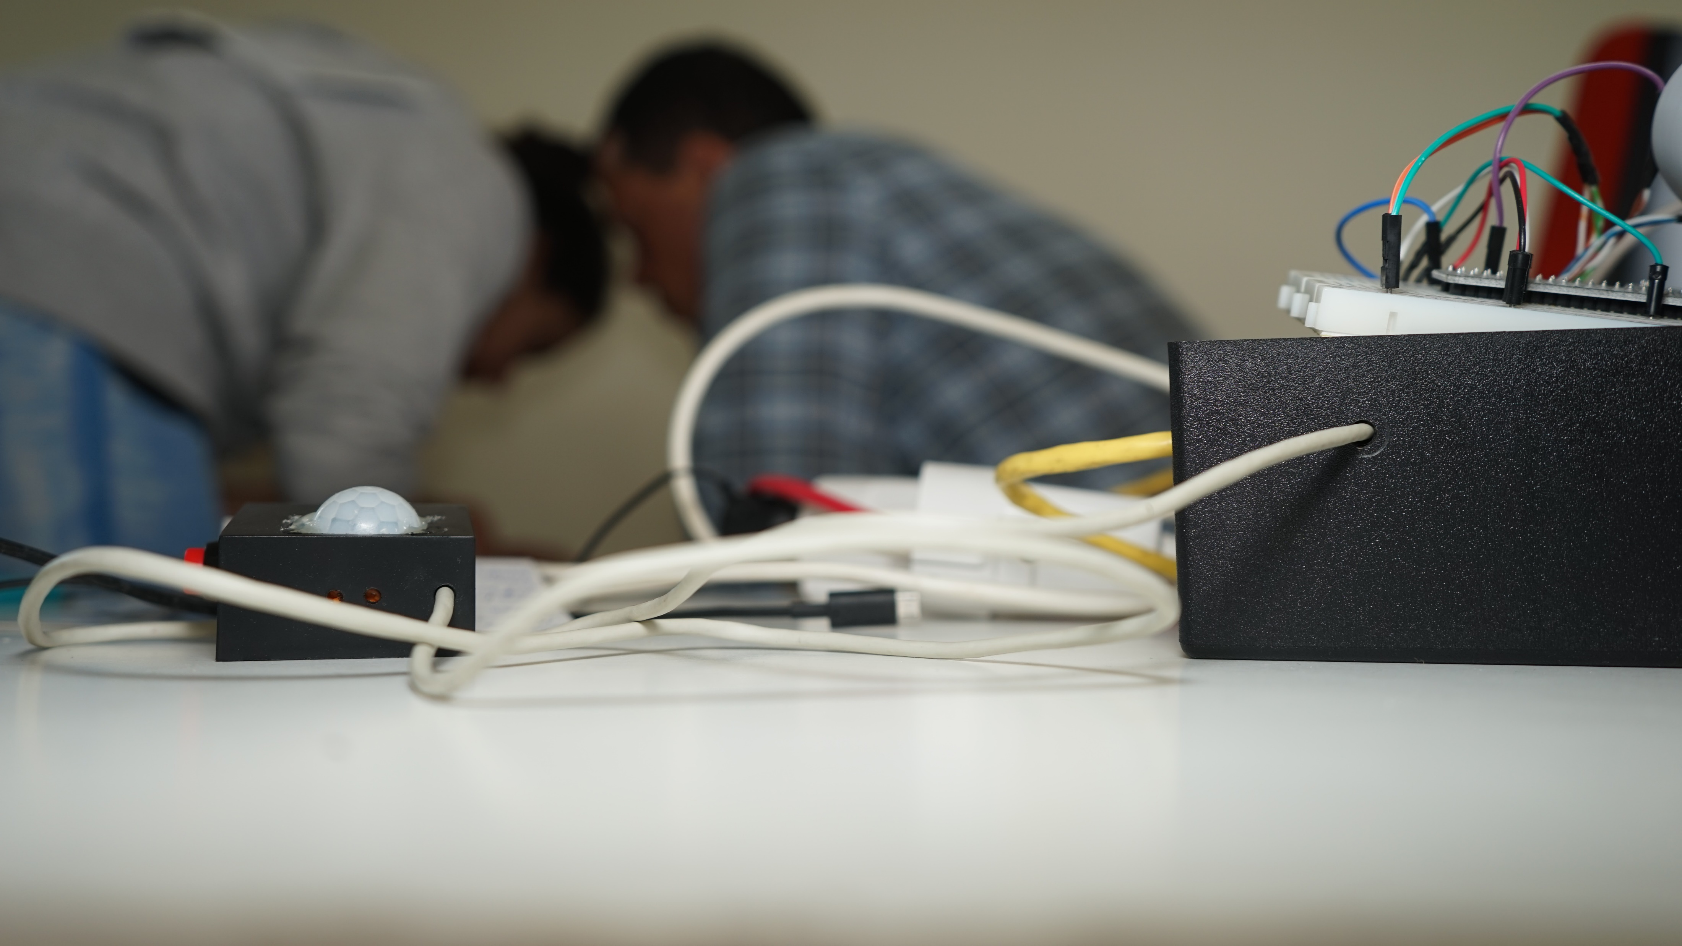
photo © Melina Zikou

Slide 16
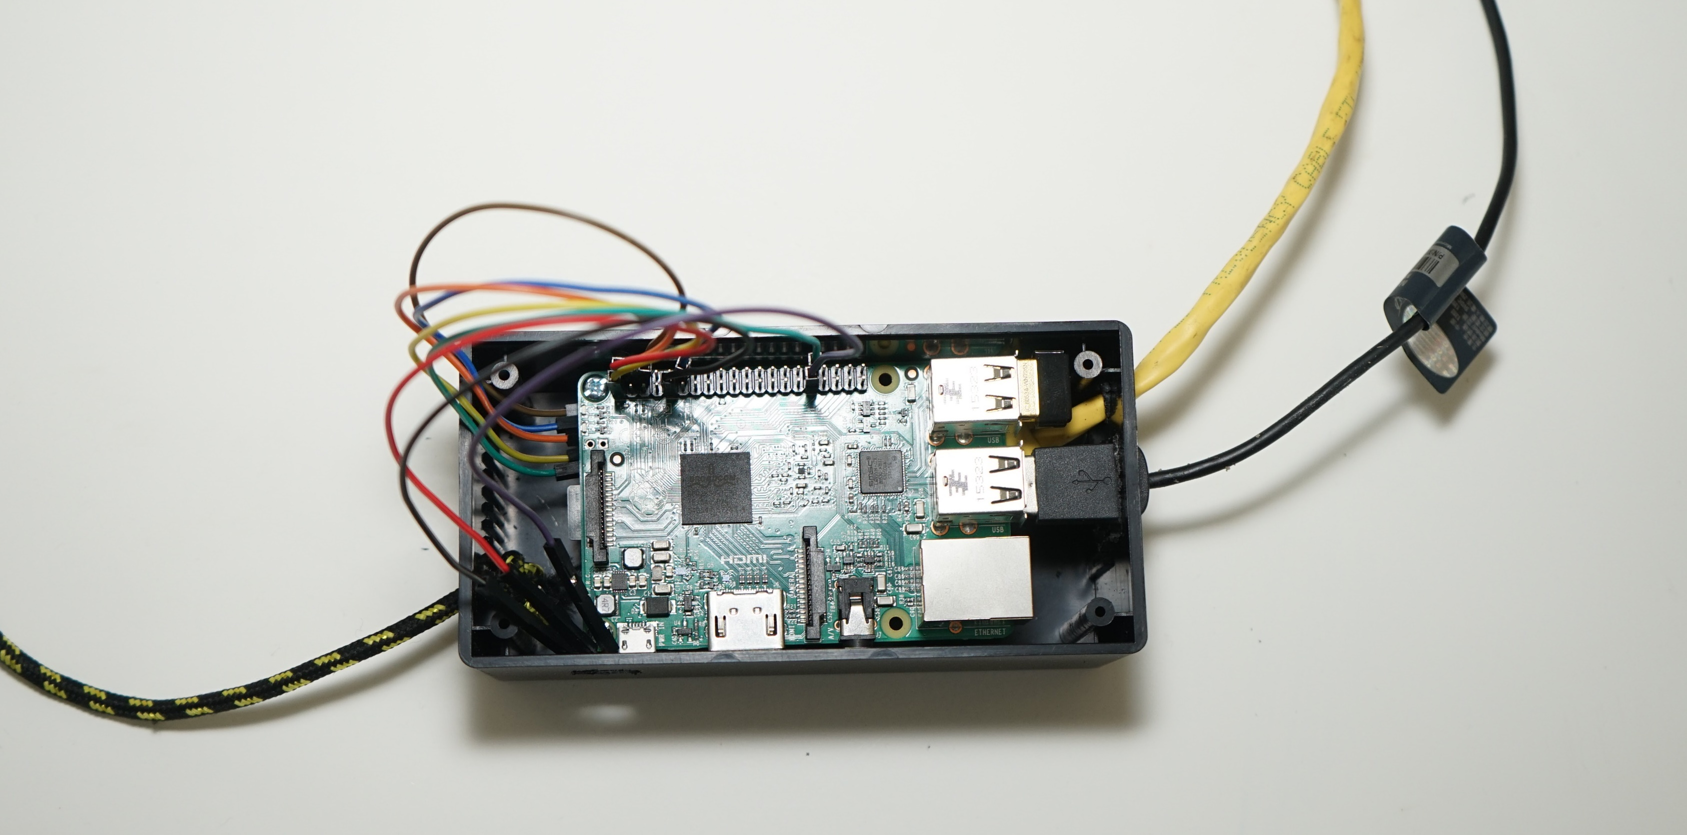
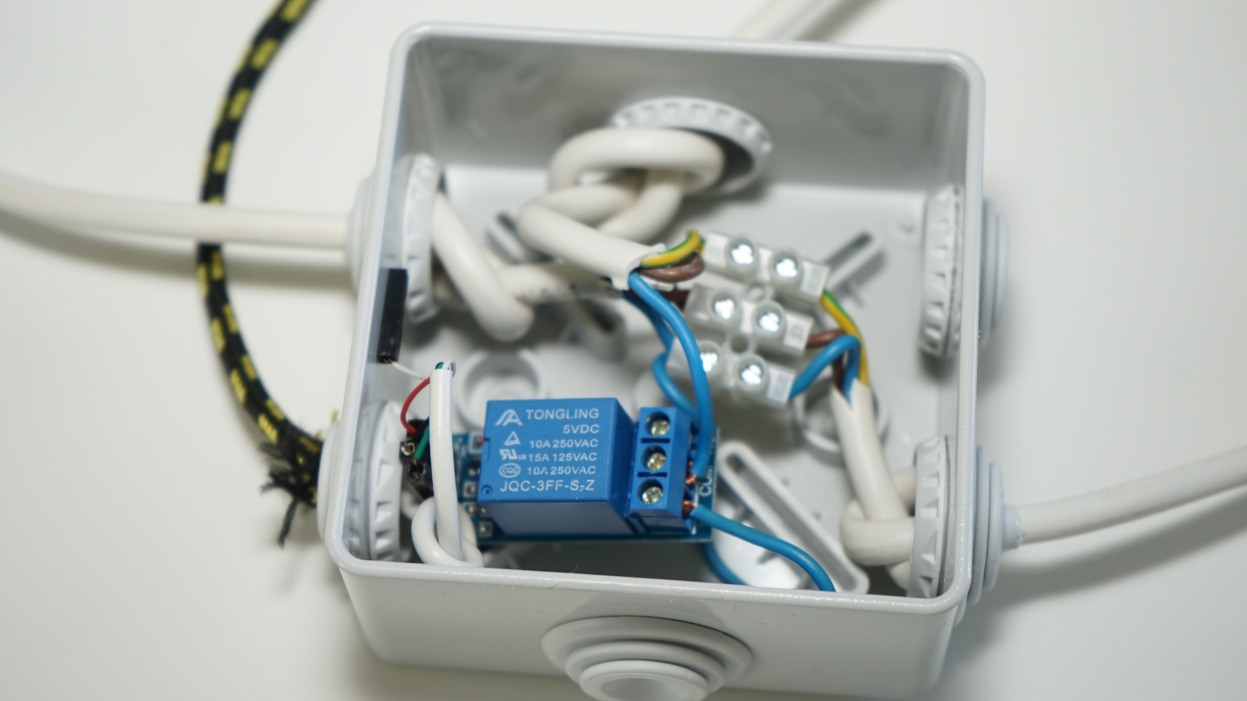
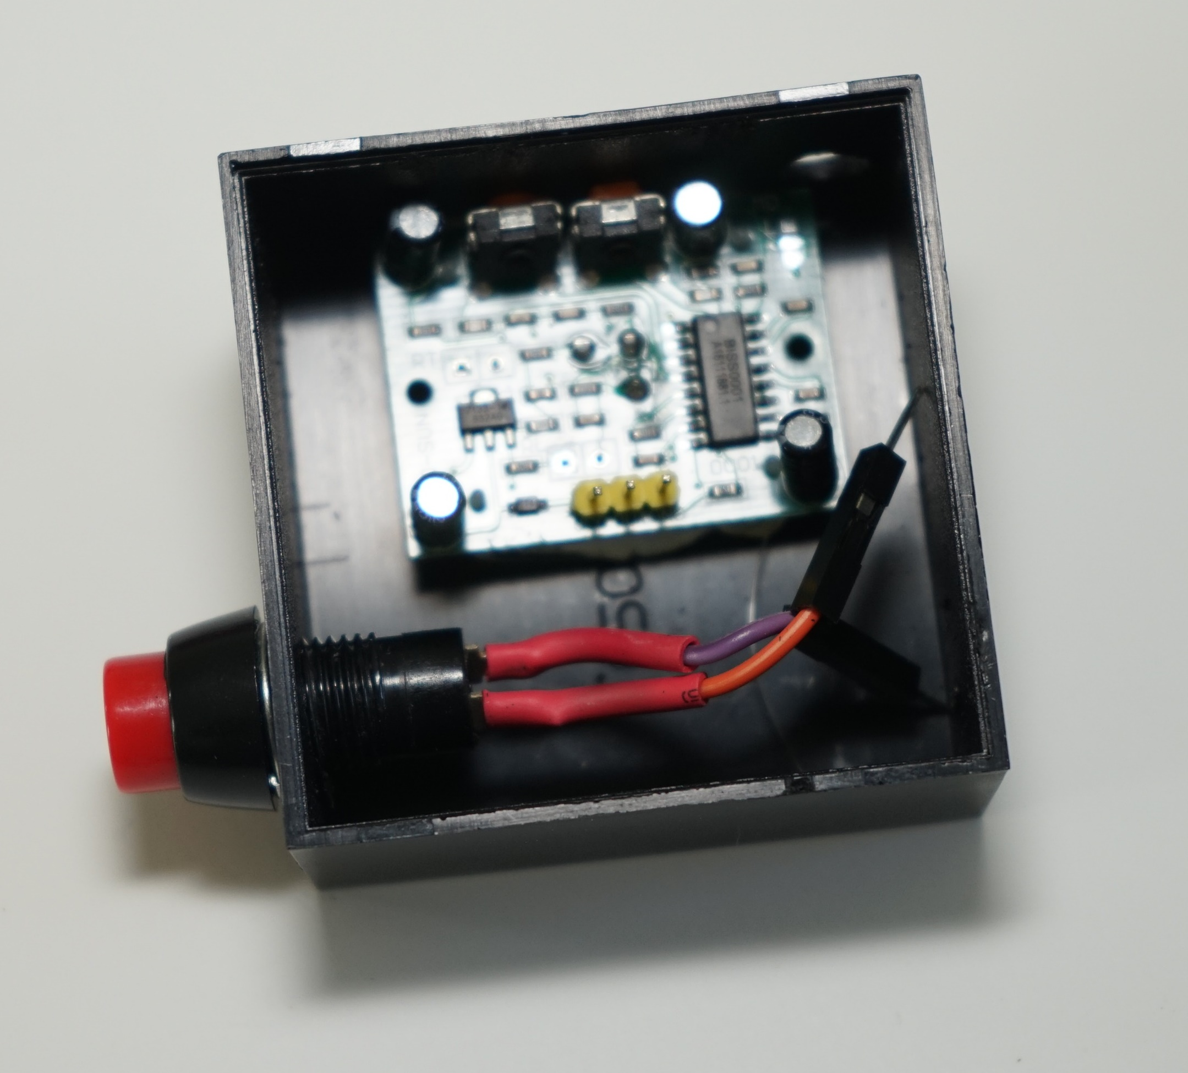
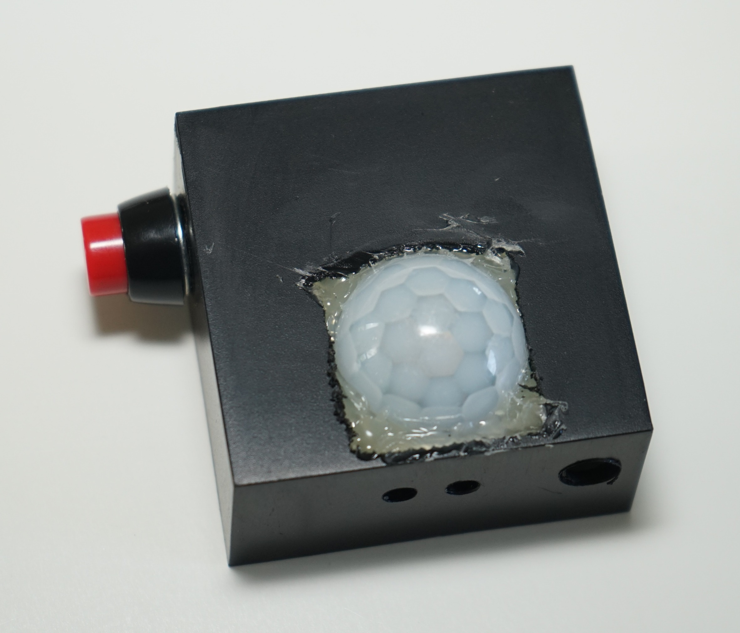
final Raspberry Pi box
final relay box
final infrared sensor and button box
photos © Melina Zikou

Slide 17
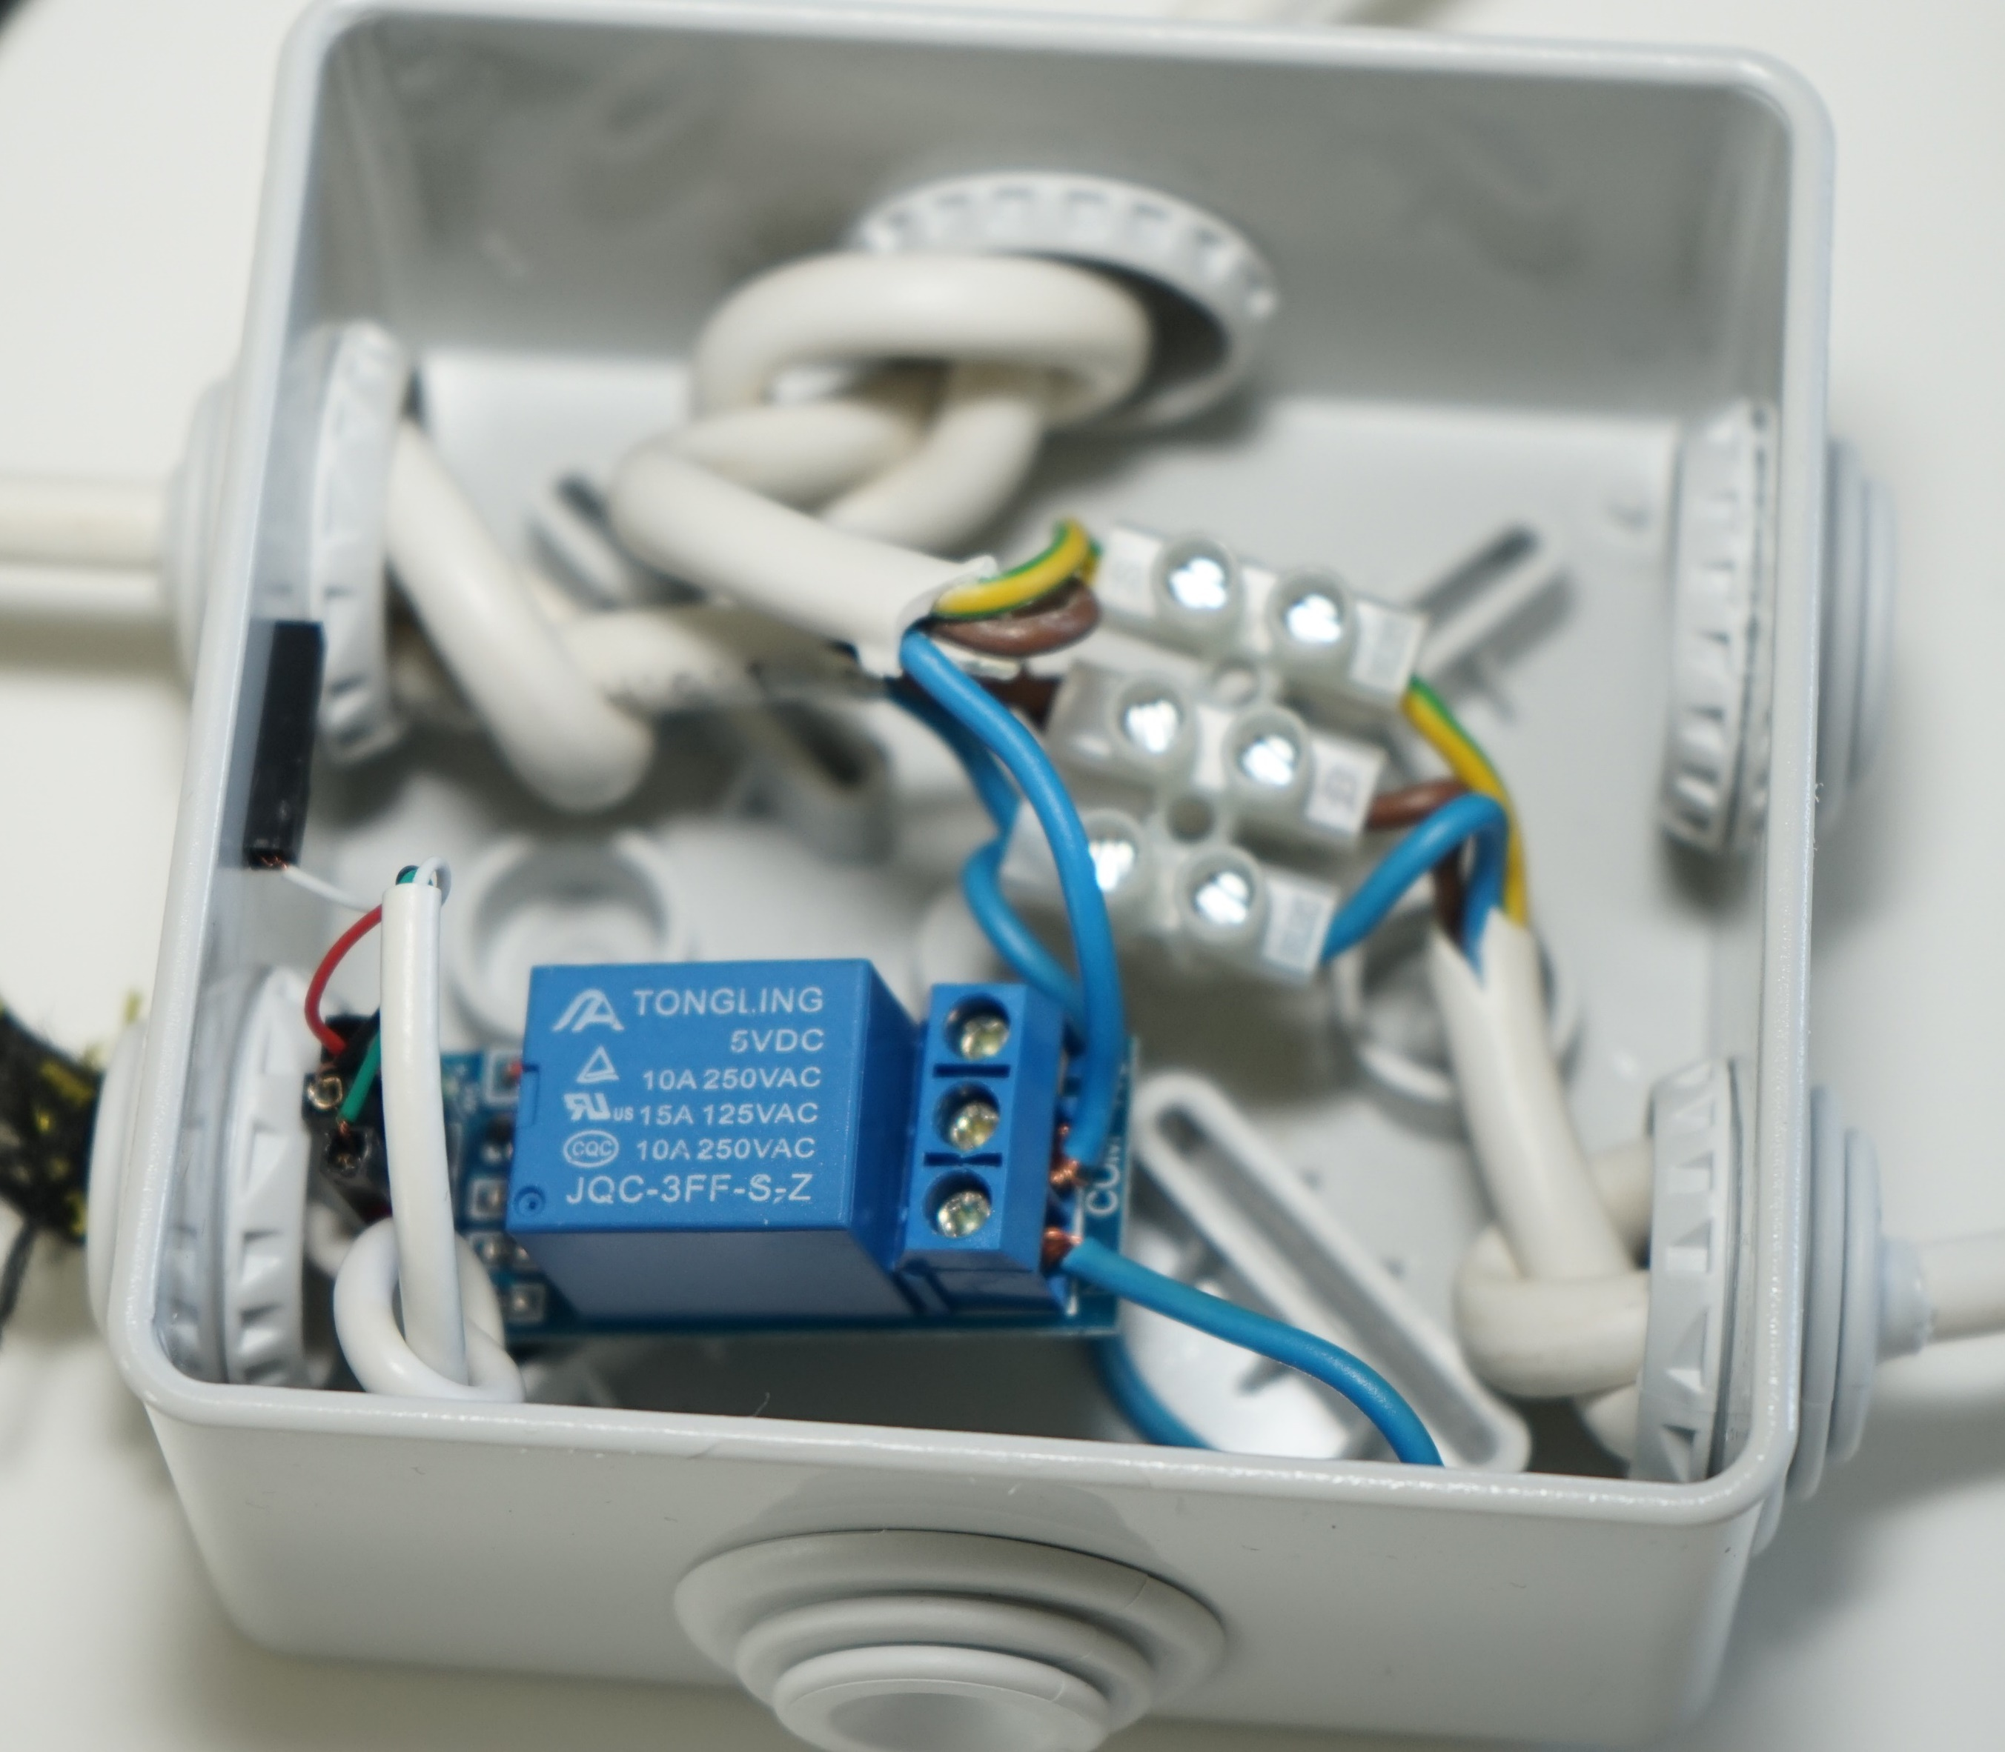
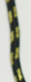

photo © Melina Zikou

Slide 18
Infrared Activity
Timing Activity
Button Activity
CODE!!!
Python Flask
Camera Activity
SQLite

Slide 19
electRuBus
=
Open Source Code
GitHub: https://github.com/NefeliZ/electRuBus

Slide 20
Save the Bear
Protect My Territory
Always Around
State 1
State 1
State 1
Infrared Sensor detects movement
Infrared Sensor detects movement
User opens light from web or manually
=>
=>
Photo is taken
=>
light opens
=>
=>
light opens
Photo is saved
=>
Action is logged to data base
=>
Action is logged to data base
Action is logged to data base
State 2
State 2
State 2
Time passes without movement detection
Infrared Sensor does not
detect movement
User closes light from web or manually
=>
=>
=>
light closes
Nothing happens
light closes
=>
=>
Action is logged to data base
Action is logged to data base

Slide 21
Watch Me
Album
Use 1
Use 1
All user actions displayed
All photos of intruders displayed
Use 2
Diagrams of hourly energy consumption
Use 3
Calculated wasted energy

Slide 22





Cv2
Time Libraries

Slide 23
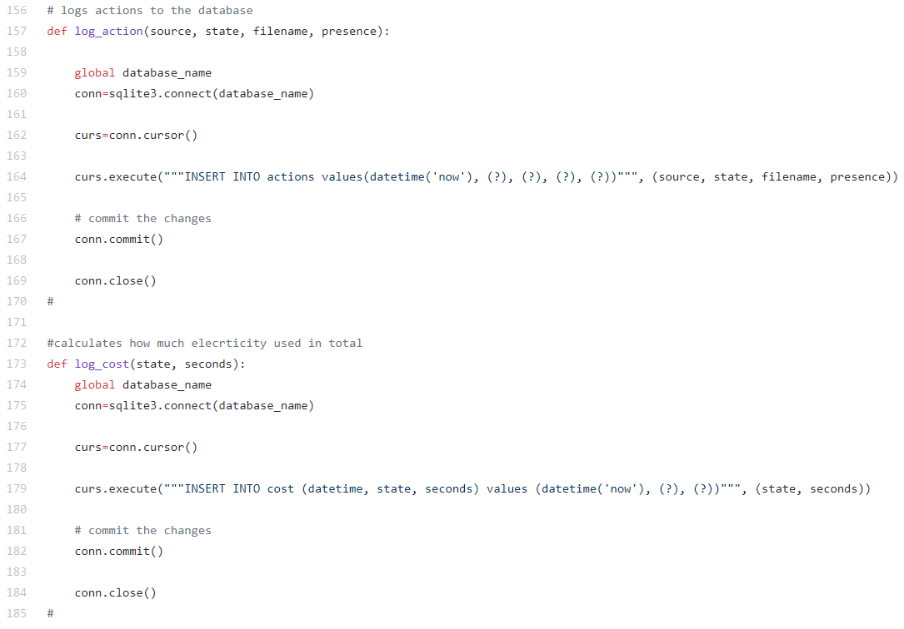
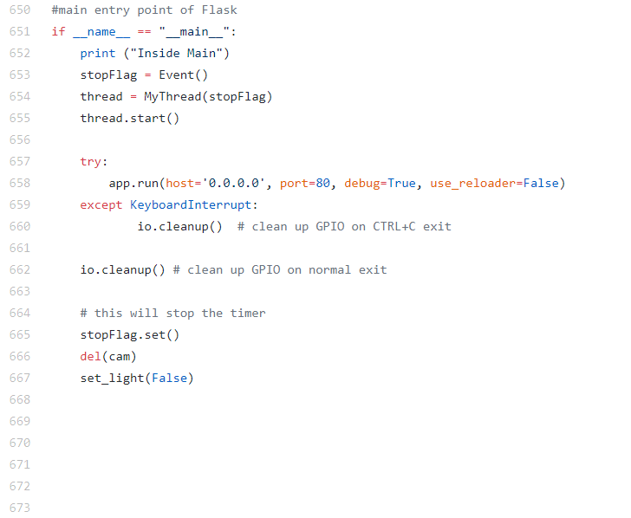

Slide 24
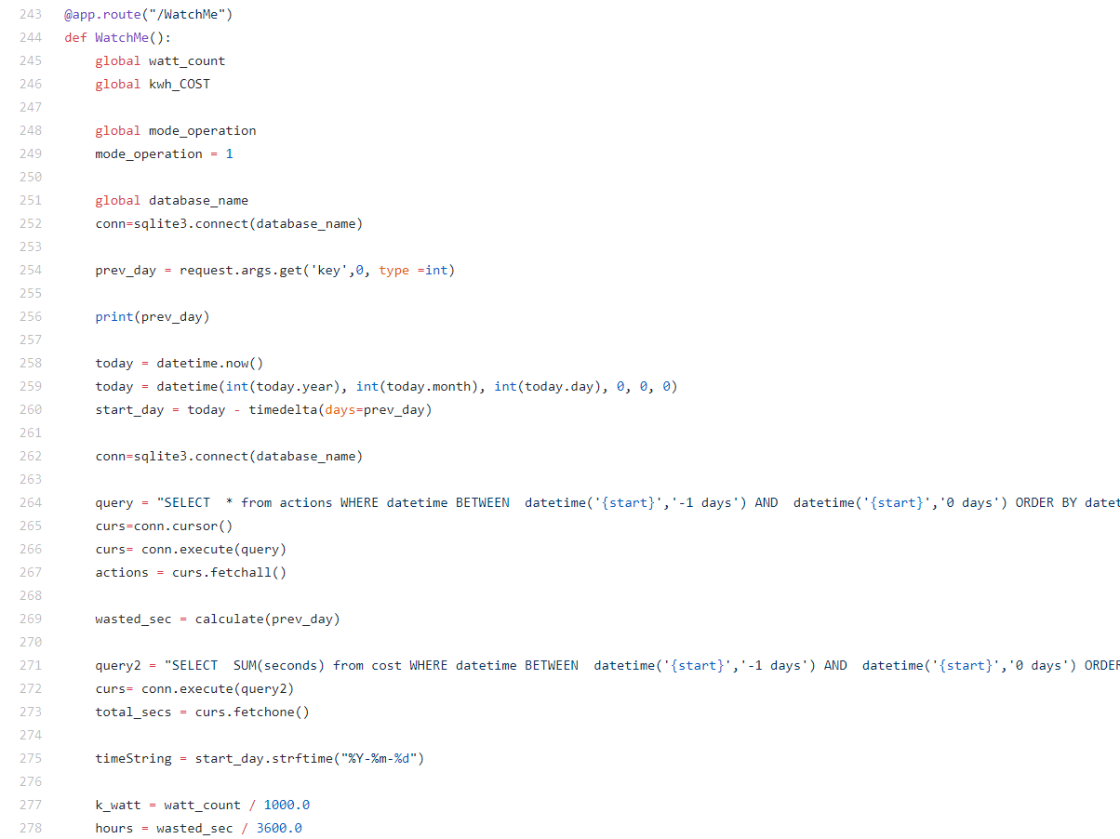
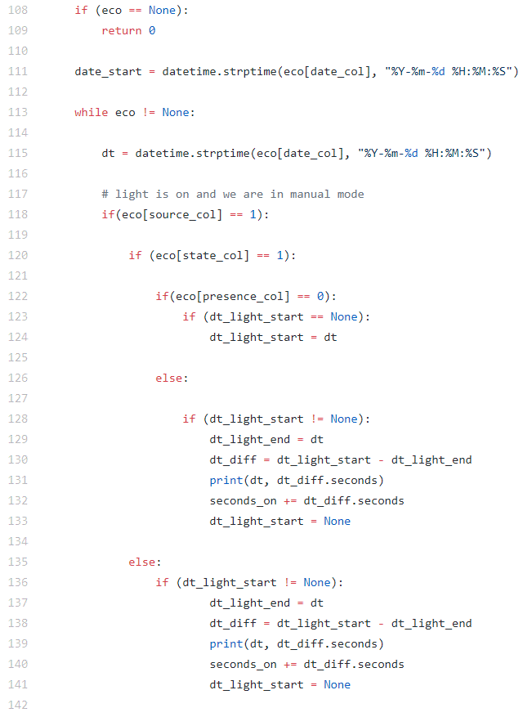
661 lines of code

Slide 25
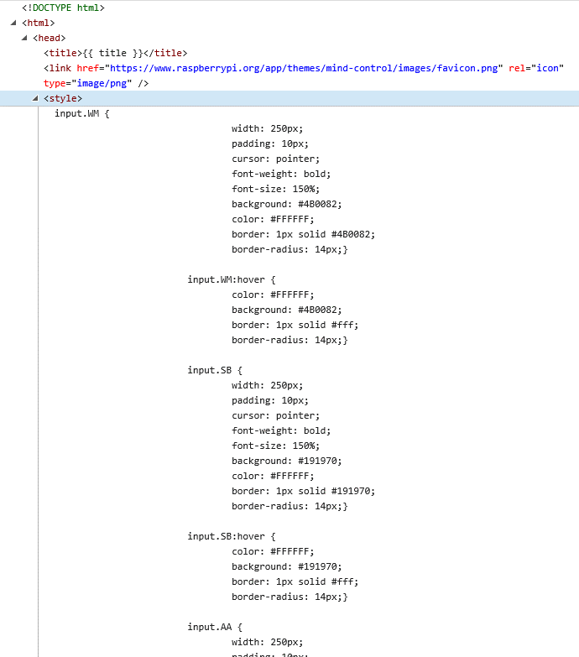
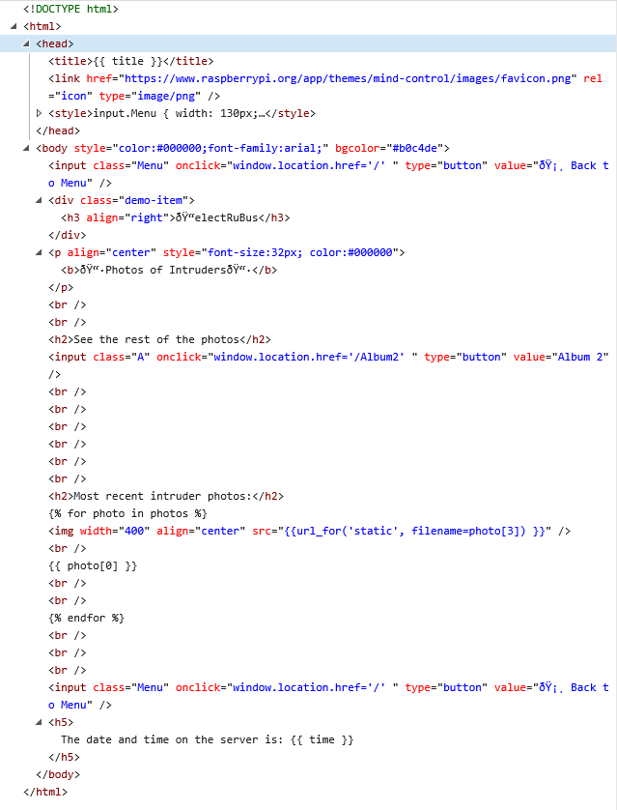

Slide 26
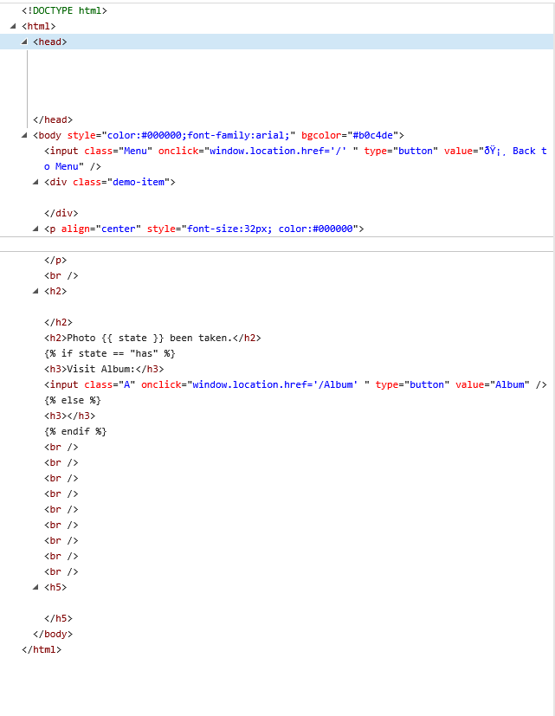
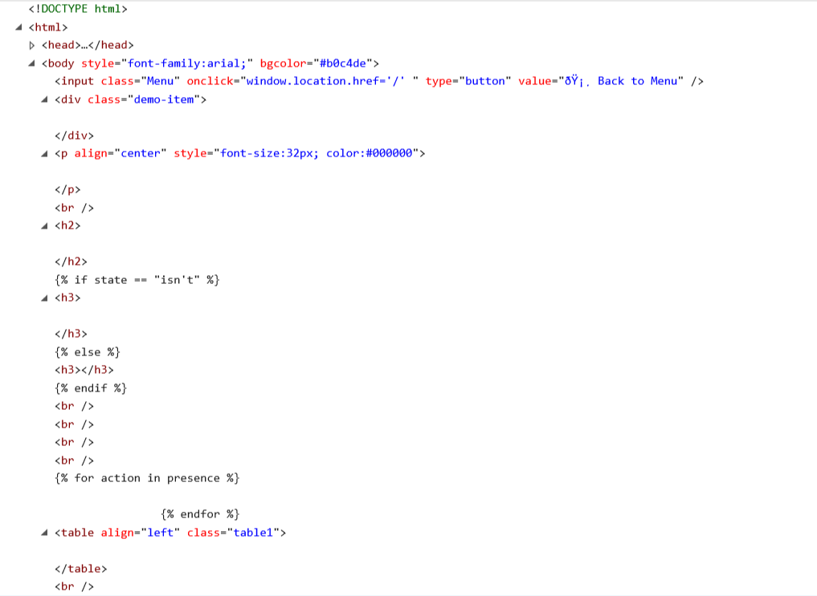
885 lines of HTML code

Slide 27
Future Work
Accessible from outside the home network
Password protection
Advanced user interaction and customization
Improvement of hardware - more compact
Large scale, randomized trial
Usability evaluation
software
hardware
deployment & evaluation

Slide 28
so, how many polar bears can you save with a raspberry pi?
© Daniel J. Cox/NaturalExposures.com, http://polarbearsinternational.org/story/through-the-season/

Slide 29
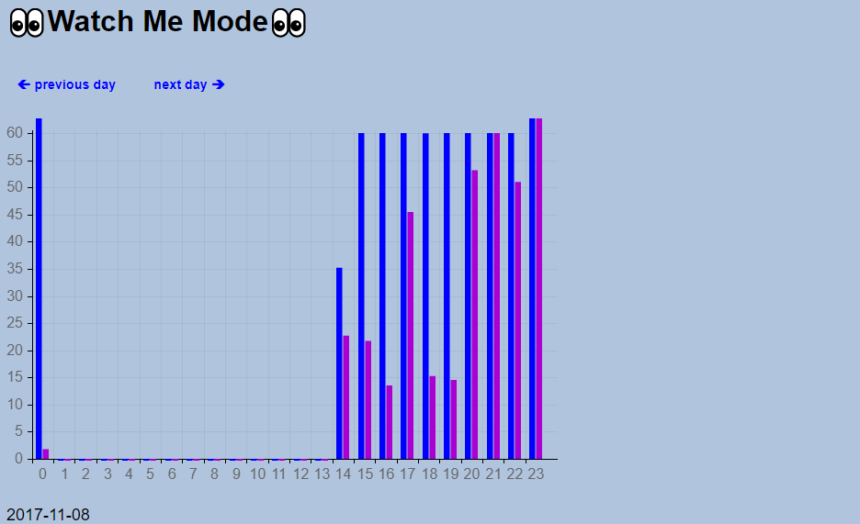
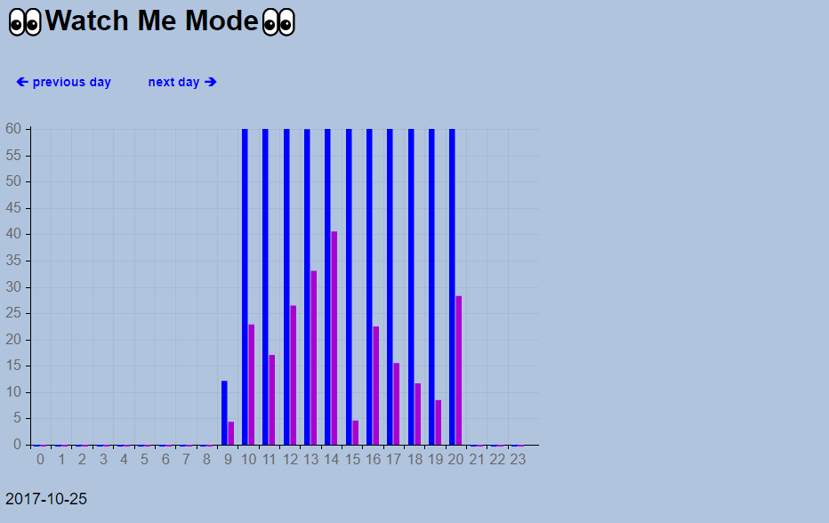
2 identical electRubus devices
2 different users
3 weeks
Total use of electricity per hour
Wasted electricity per hour
1
2
2017-10-06
2017-10-06

Slide 30
User 1
total
wasted

Slide 31
User 2
total
wasted

Slide 32

User 1
58.66
58.66 % of time wasted
= 70 W
total for 3 weeks
Wasted: 10.7 KWh
in 1 Year
Wasted: 104 KWh
>
Emitted: 77,4 kg CO₂
kg

Slide 33

User 1
58.66
58.66 % of time wasted
= 70 W
in 1 Year
Wasted: 104 KWh
Equivalent to
0.21 m² of ice loss
Counter-balanced by 2 tree seedlings grown for 10 years
2 x
Greenhouse Gas Equivalencies https://www.epa.gov/energy/greenhouse-gas-equivalencies-calculator

Slide 34
x 200 million European households
0.3% of Antarctica's surface in ice

Slide 35
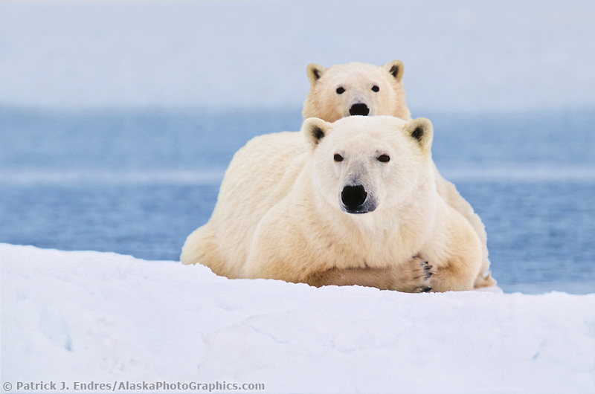
“Η ισχύς εν τη ενώσει”
Αίσωπος
“Together we stand, divided we fall”
Pink Floyd

Slide 37
Slideshare: Nefeli Zikou http://www.slideshare.net/NefeliZikou

